Slide 1
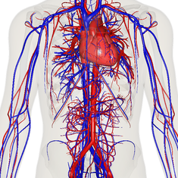
Cardiovascular System

Slide 2
Blood
Brainstorm: What do you already know about blood?
- What types of cells?
- What type of tissue?
- Diseases?
- Where made?
Objective: Students will be able to describe the pathway of blood flow through the heart and the regions of the heart.

Slide 3
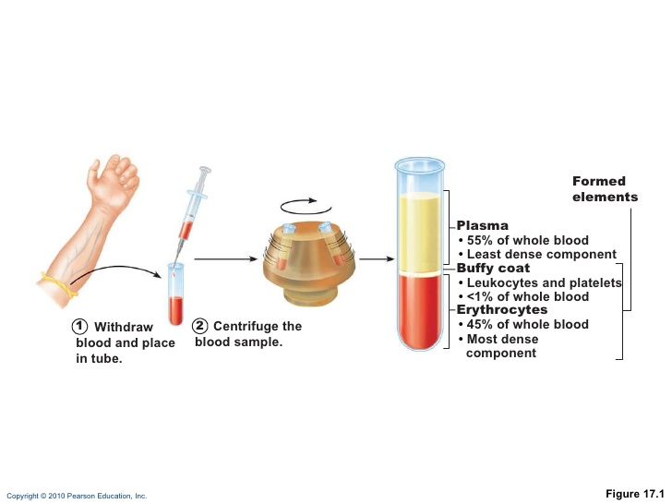
The Components of Blood

Slide 4
The components of blood
The only fluid tissue of the body- cellular and liquid parts
45% erythrocytes- RBCs – transport oxygen
“Hematocrit” - percentage of RBCs
WBCs- <1%- leukocytes – WBCs and platelets
Plasma- nonliving fluid matrix
Carries dissolved hormones, gases, wastes, electrolytes
Accounts for 8% of body weight!
About 1.5 gallons in average man.

Slide 5
Blood- Functions
Functions:
Deliver oxygen from lungs to tissues
Transport wastes to elimination sites
Kidney- nitrogen waste
Lungs- CO2
Hormones to target organs
Maintain body temperature
Maintaining pH – 7.35-7.45
Clotting to prevent blood loss
Preventing infection VIA WBCs

Slide 6
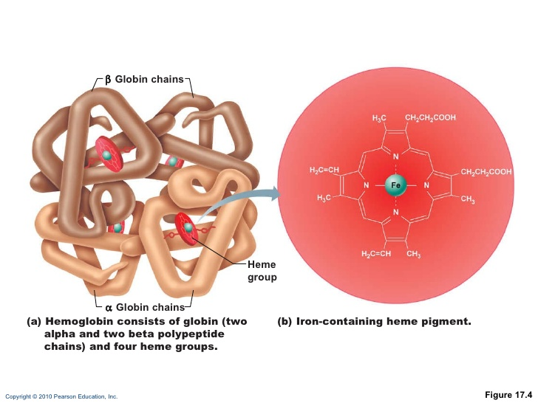
Red Blood Cells
No nuclei or organelles
Stem cells in bone marrow continuously make them.
Hematopoiesis
Flattened discs on microscope
^ surface area for gas exchange
97% Hemoglobin- protein for carrying gases
A single RBC has 250 million Hb
Each cell can pick up 1 billion O2
Do not have mitochondria- so do not require oxygen
Has iron molecule in its center
Binds the oxygen
Live for 100-120 days
Spleen “eats” them
Recycle Iron
Macrophages eat heme portion
Bilirubin- secreted into the intestines

Slide 7
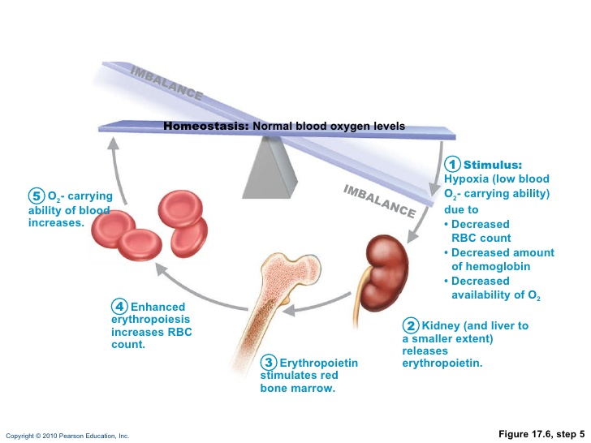
Erythropoiesis
Keeping constant RBC numbers helps prevent oxygen deprivation
Hypoxia
More than 2 millions RBCS a second are produced!
Erythropoietin- hormone that controls RBC production
Produced by the kidneys mostly (liver)
Notes:
Athletes abuse synthetic EPO, increase hematocrit by 45- 65%. Increased stamina performance. But blood becomes stickier and thicker, increased stroke risk and heart failure. Renal failure inject it to helep/. Blood doping- taking blood out and allowing body to replace then injecting back in.

Slide 8
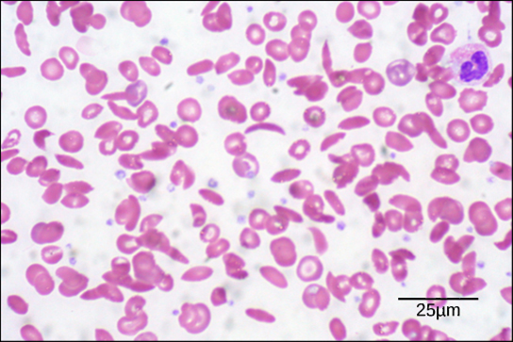
RBC issues
Anemia- decreased oxygen carrying capacity of blood
Sx: Fatigue, shortness of breath, pale, cold
Causes:
Rapid blood loss – treated by replacing blood
Chronic blood loss- bleeding ulcer or hemorrhoids.
Iron deficiency- need to supplement iron
Pernicious- autoimmune in elderly
Loss of vitamin B12 which helps RBCS form
Also happens in vegetarians who lack b12 (shot)
Aplastic- radiation or drugs
Sickle cell

Slide 9
White Blood Cells-Leukocytes
Complete Cells
Mobile army against viruses, parasites, toxins, tumor, bacteria
Able to leave capillaries
High amounts = leukocytosis
Indicates body fighting an infection
Low amounts= leukopenia
Chemical signals tell them where to go

Slide 11
Roles of WBCs
Neutrophils – eat bacteria (ex. Meningitis, appendicitis)
Lymphocytes- immune system response
“T” – Attack cells directly
“B” – Produce antibodies
Monocytes- develop into macrophages
First line of defense against viruses and some bacteria
Eosinophils- attack parasitic worms, role in allergies / asthma
Basophils- Release Histomine
Vasodilator
Attracts other WBCs to site

Slide 12
End of Day 1

Slide 13
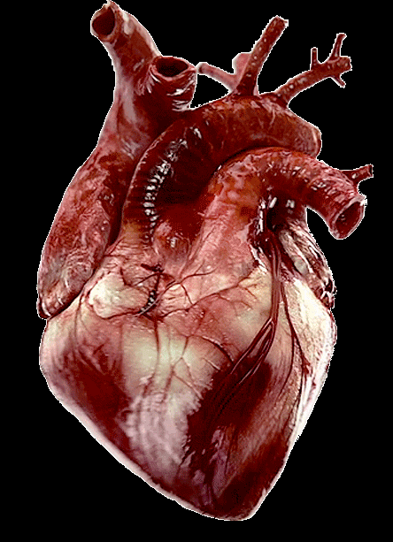

Slide 14
Blood Typing
1. What is the composition of blood?
2. Where is blood make/ recycled?
3. What organ stimulates blood production/ Which hormone?
4. What are the 5 most prevalent WBCS?
Objective: Students will be able to describe the pathway of blood flow through the heart and the regions of the heart.

Slide 15
Blood Clotting
Carried out by Platelets – fragments of cells
Inner lining of blood vessels = Endothelium
Simple Squamous
Without clotting even a small cut would results in massive blood loss

Slide 16
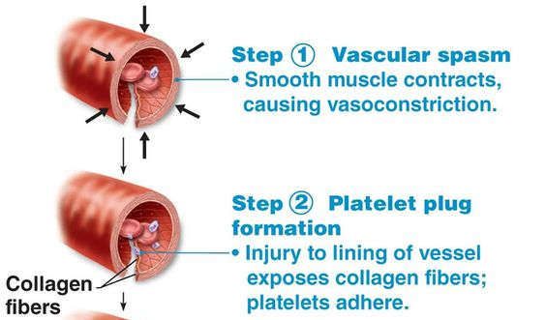
Notes:
Constrictions allows time for the next two steps . Step 2 platelets stick together temporarily sealing the tear. Platelets are good for smaller tears but larger ones require other steps.

Slide 17
Notes:
Step 3: coagulation – blood clotting – fibrin threads lay down

Slide 18
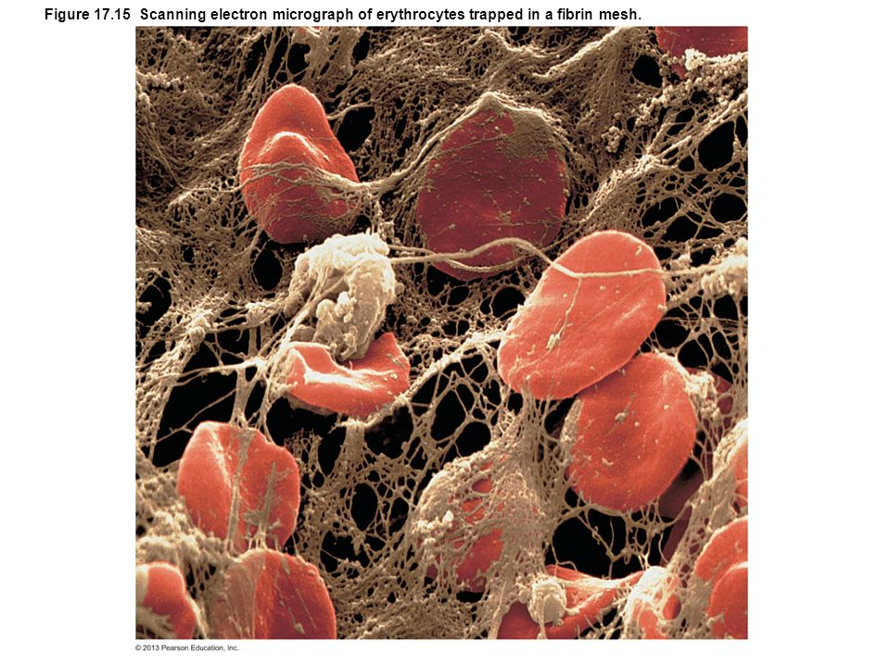

Slide 19
Repairing a clot
Blood clots form continuously in your vessels due to normal wear and tear and would gradually block the vessels.
Platelets release a chemical to stimulate smooth muscle and fibroblasts to begin to replicate.
The clot is completely gone within several days.

Slide 20
Clotting disorders
Thrombus- clots in unbroken blood vessels
Could impair blood flow such as in the heart
Embolus- a thrombus that breaks away
Pulmonary embolism- travels to lungs and becomes trapped
Greatly impacts oxygen

Slide 21
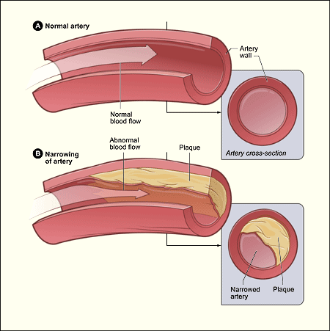
Atherosclerosis
Roughens artery walls and causes increased clot formation.

Slide 22
Helpful Drugs for clotting
Anticoagulant drugs
Aspirin- low dose can reduce heart attack up to 50% if used every day
Inhibits a chemical that is used to promote platelet sticking
Warfarin (Coumadin)- reduce stroke risk in patients with Atrial fibrillation where blood pools in heart.
Interferes with vitamin K production which is used to make clotting chemicals
Notes:
Warfarin an ingredient in rat poisen

Slide 23
The Immune System
Antigens- Proteins on the cell membrane of cells.
Body can recognize your cells versus foreign cells
Antibodies- Produced by B lymphocytes
Recognize foreign invaders and connect to them
When receiving blood:
It is never bad to have extra antigens in your blood
Your body will always attack an antigen that you do not have!

Slide 24
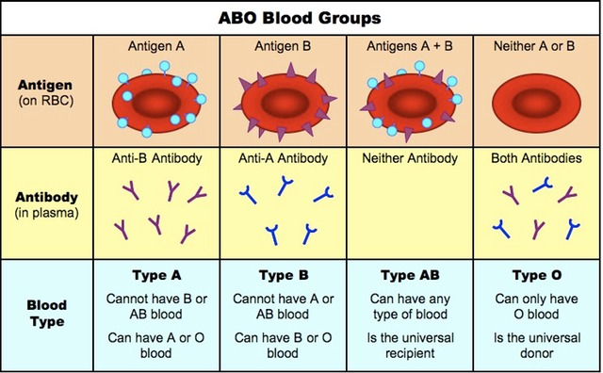
ABO Blood types
Notes:
that development of the antibodies occur due to microbes living in our body having antigens similar to other blood group's antigens

Slide 25
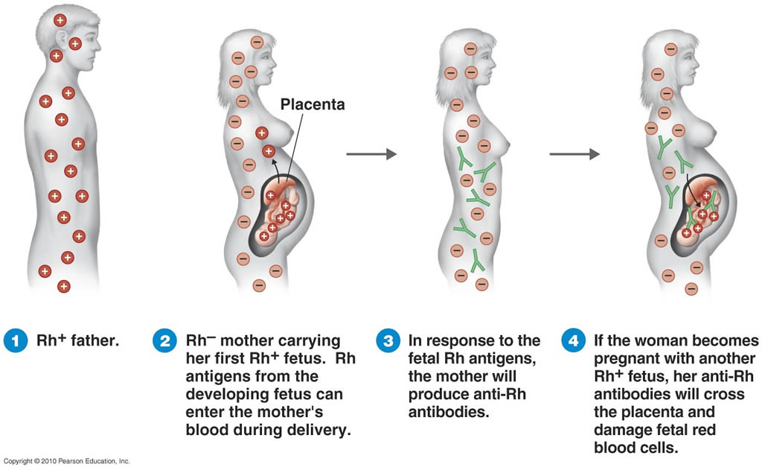
Rh factor – 85% are positive
Notes:
Same with blood transfusions

Slide 26
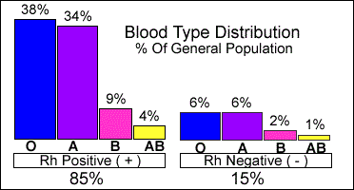

Slide 27
End of Day 2

Slide 28
Heart Blood Flow
What is the process of forming a blood clot?
What is an embolus?
What is an antigen? How many are important in blood typing? What are they?
What type of blood can a B+ person receive? Give?
Objective: Students will be able to describe the pathway of blood flow through the heart and the regions of the heart.

Slide 29
ABO Blood types
Notes:
that development of the antibodies occur due to microbes living in our body having antigens similar to other blood group's antigens

Slide 30
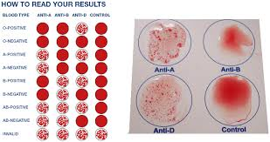
Blood Types Who is the universal donor?

Slide 31
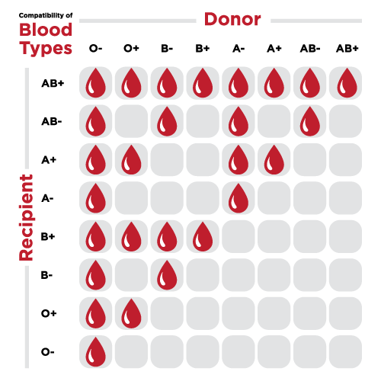

Slide 32
Structure of the Heart
Heart Size – about the size of a fist
Located in the pericardium
- Parietal and visceral layer
The distal end of the heart is called the apex.

Slide 33
Heart Chambers & Valves
Heart has 4 chambers:
2 Atria – thin upper chambers that receive blood returning to the heart through veins.. Right and Left Atrium
2 Ventricles – thick, muscular lower chambers. Receive blood from the atria above them. Force (pump) blood out of the heart through arteries. Right and left ventricle.
Septum – separates the right and left sides of the heart

Slide 35
Valves of the Heart
(2 Atrioventricular Valves (AV) & 2 Semilunar valves)
Left Atrioventricular valve – also called the bicuspid valve or mitral valve. Between left atrium and ventricle
Right Atrioventricular valve – also called the tricuspid valve. Between right atrium and ventricle
Aortic Semilunar – or just aortic valve. Between the left ventricle and the aorta
Pulmonary Semilunar, or just pulmonary valve. Between the right ventricle and the pulmonary artery

Slide 37
Check your labels!

Slide 38
Name the valves

Slide 39
1 Pulmonary Valve 2 Tricuspid Valve 3 Mitral (Bicuspid) Valve 4 Aortic Valve 5 Heart Apex

Slide 40
End of Day 3

Slide 41
Heart Blood Flow
What are the 4 major valves?
Why do we have valves?
Objective: Students will be able to describe the pathway of blood flow through the heart and the regions of the heart.

Slide 42
Systemic Circulation – delivers blood to all body cells and carries away waste
Pulmonary Circulation – eliminates carbon dioxide and oxygenates blood (lung pathway)

Slide 43
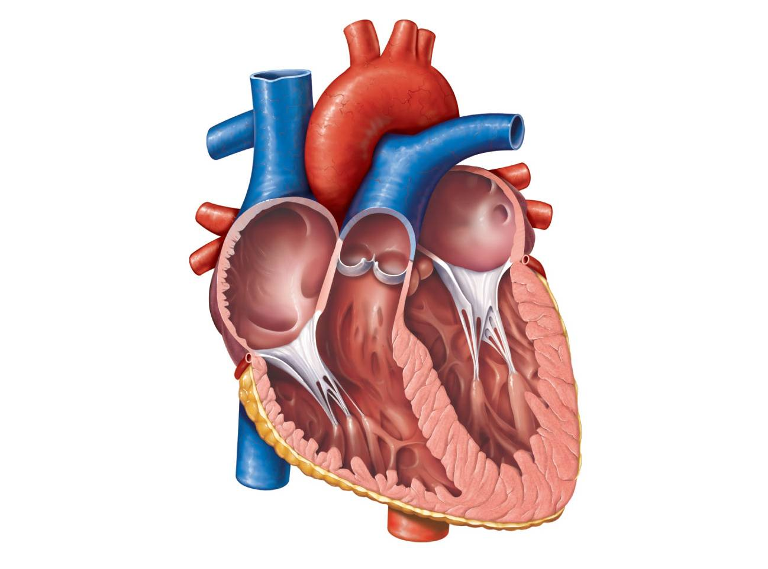

Slide 44
Layers of the Heart
Serous Pericardium
Parietal Layer- outer
Visceral layer- inner. Aka “epicardium”
On the heart muscle itself
Myocardium- cardiac muscle
Endocardium- squamous
Pericardial cavity- fluid for lubrication

Slide 45
Blood flow and Valves
https://www.youtube.com/watch?v=noHteY8tOXM

Slide 46
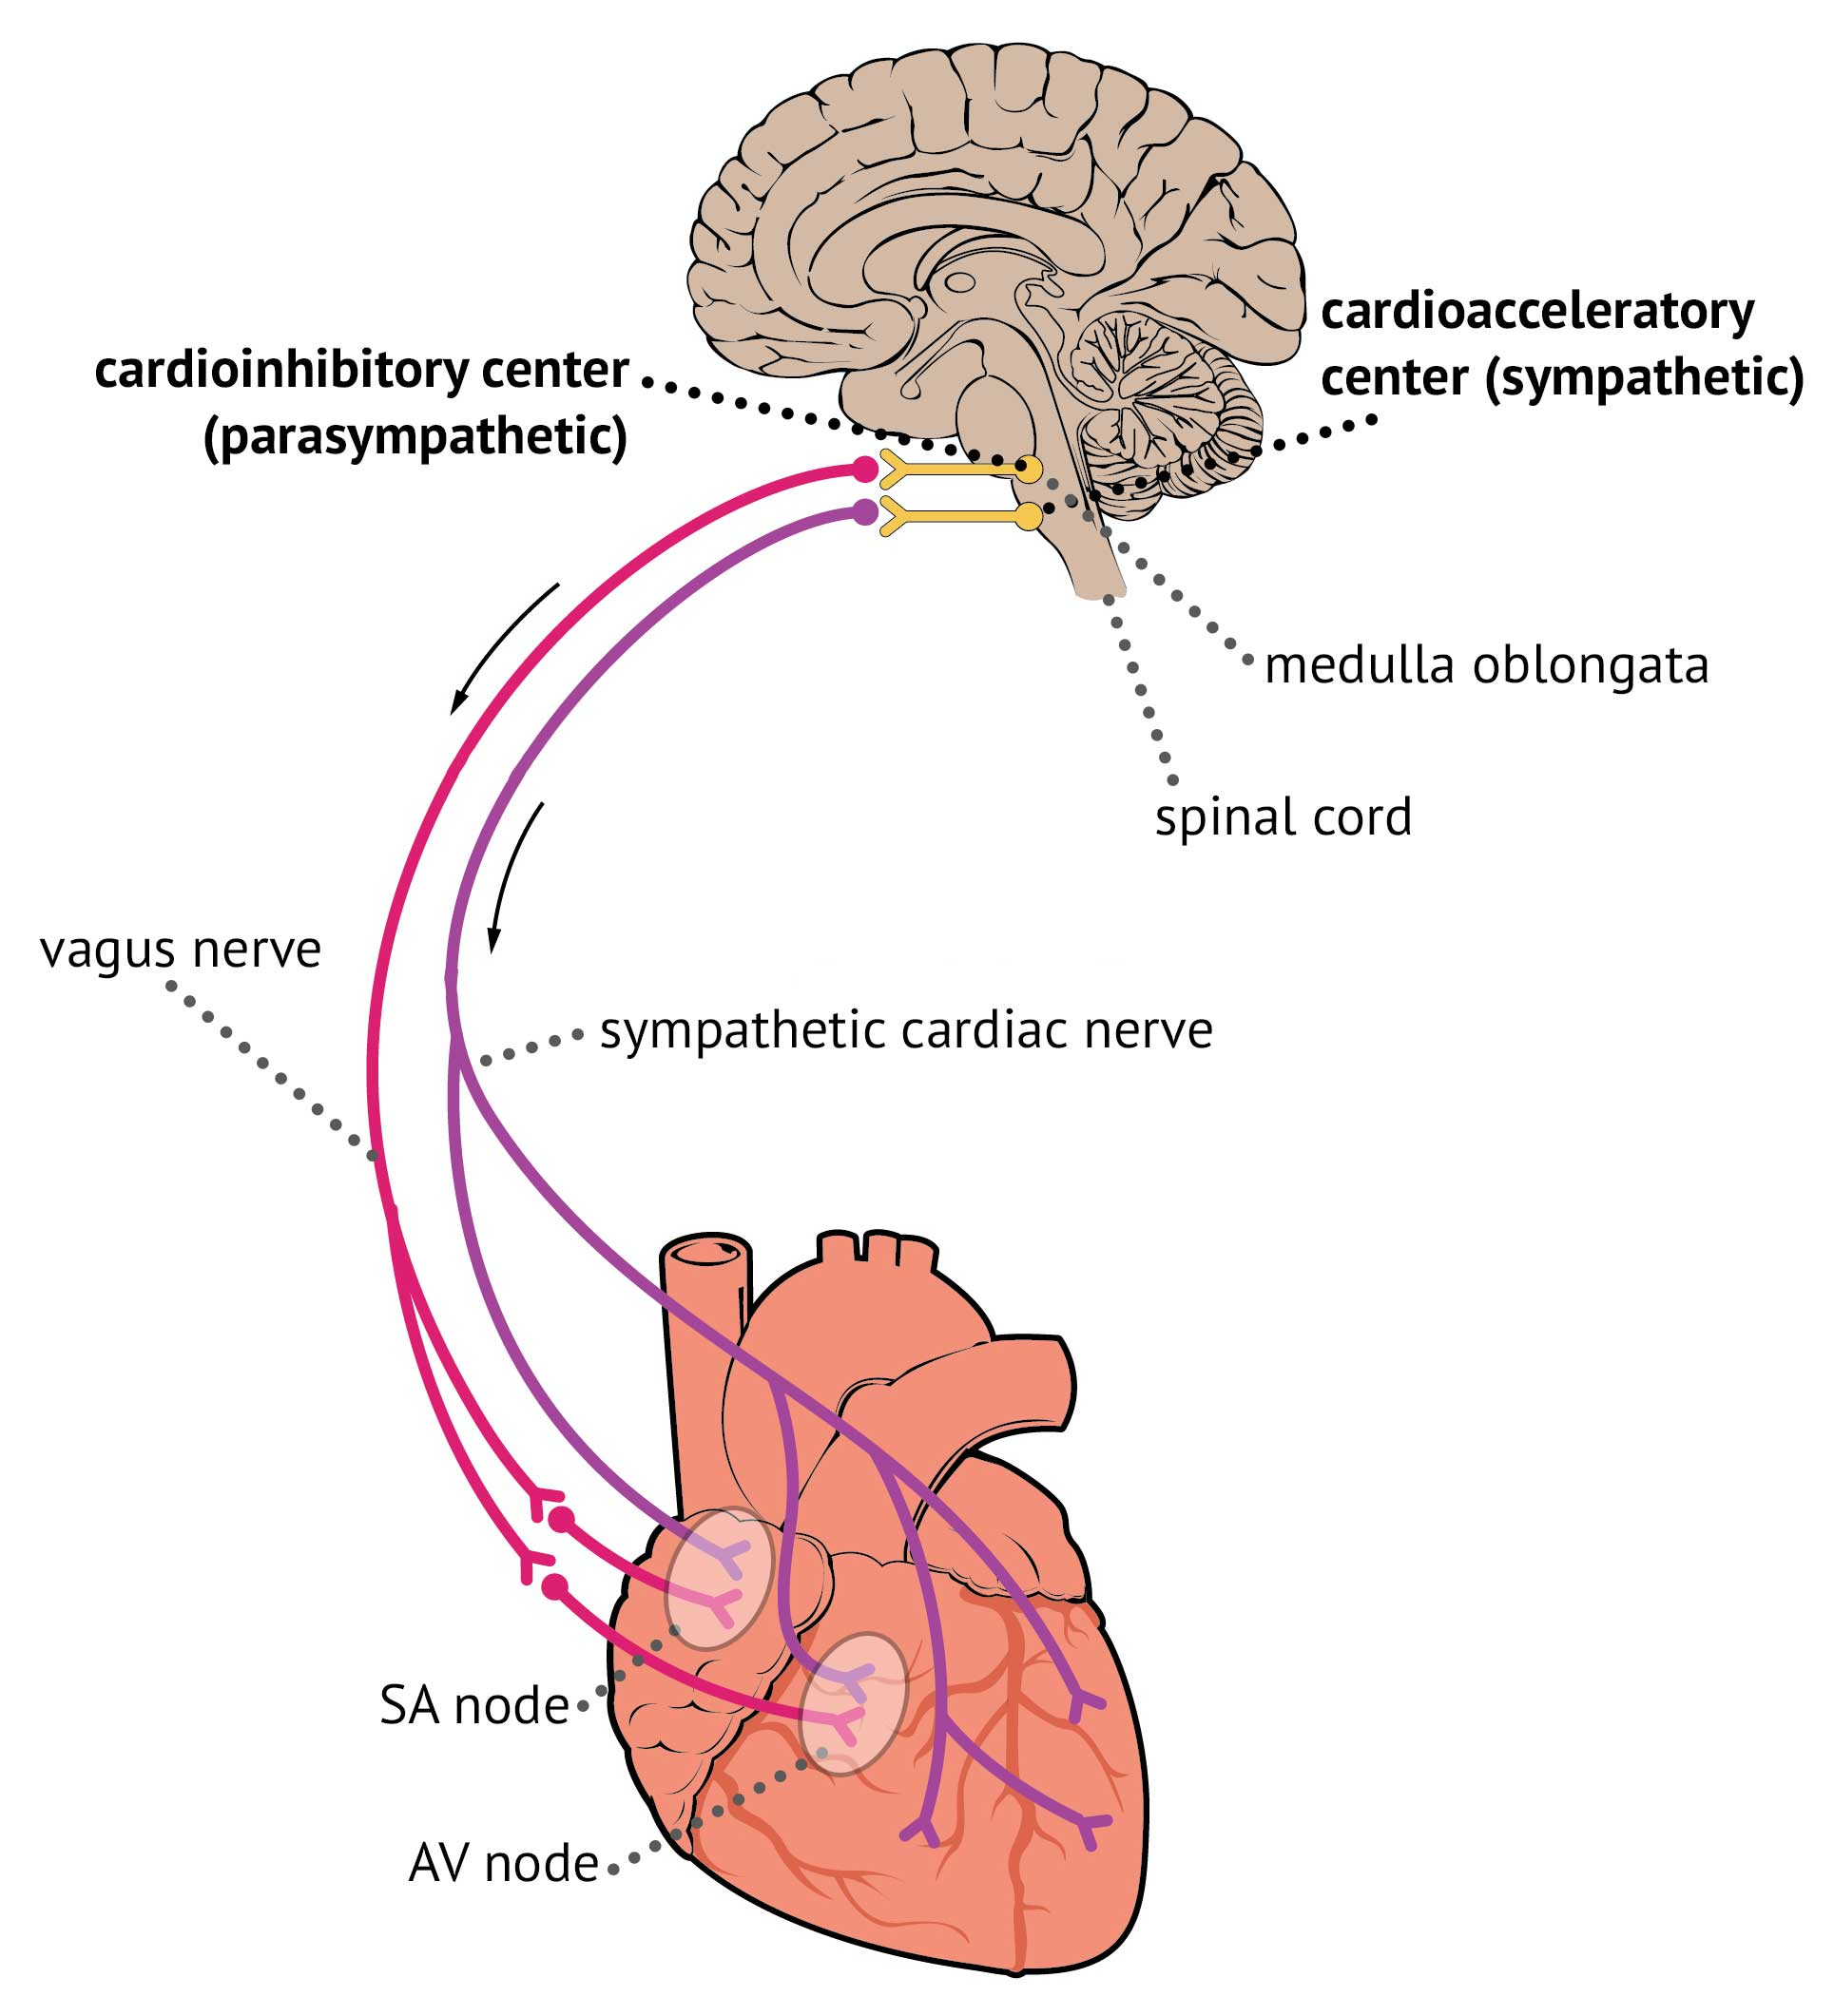
Nerve supply to the heart
Cardiac center is in the medulla
Sympathetic- speeds up HR / blood flow
Parasympathetic- Vagus nerve - Decreases

Slide 47
Heart contractions
Contracts as a unit- i.e. can never just contract the right side and not the left
Remember: Every single skeletal muscle fiber needs and individual nerve
Very similar steps to that of the skeletal muscle contraction
Relies almost exclusively on aerobic respiration
Lasts for minutes without oxygen before death.

Slide 48
Electrical System of the heart
SOME cardiac cells are self excitable (1%)- Can initiate their own depolarization and the rest of the heart
SA Node- pacemaker region of heart
Even if all of the nerves to the heart are severed, the heart will continue to contract.
ANS can alter rate
AV node- delays impulse to allow atrium to contract first.
Only connection between atrium and ventricles
No gap junctions

Slide 49
https://www.youtube.com/watch?v=298puWjGaw8

Slide 50
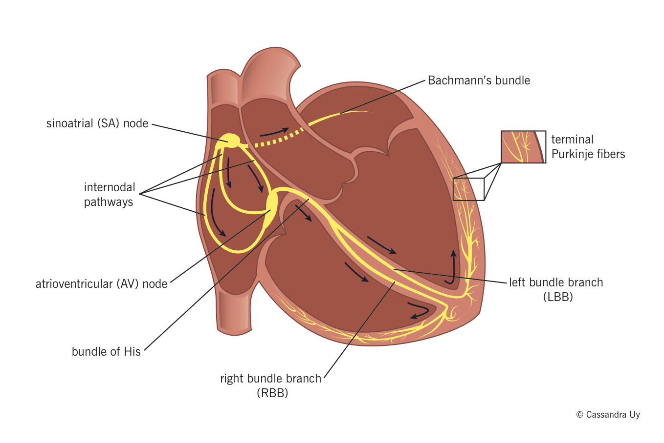

Slide 51
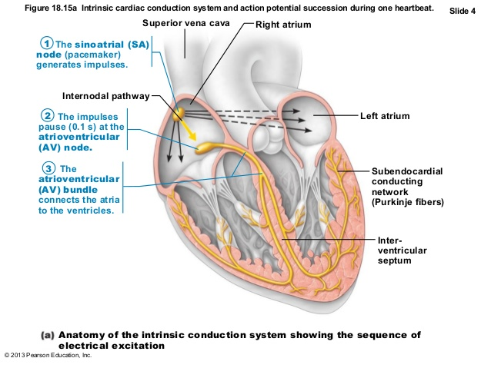
Electrical events of the heart
Notes:
SA- 75 beats per min. av THINK OF traffic merging from 3 to 2 lanes. Bundle of His allows atria to contract before ventricles. Purkinje fiberse

Slide 52
https://www.youtube.com/watch?v=fZT9vlbL2uA

Slide 53
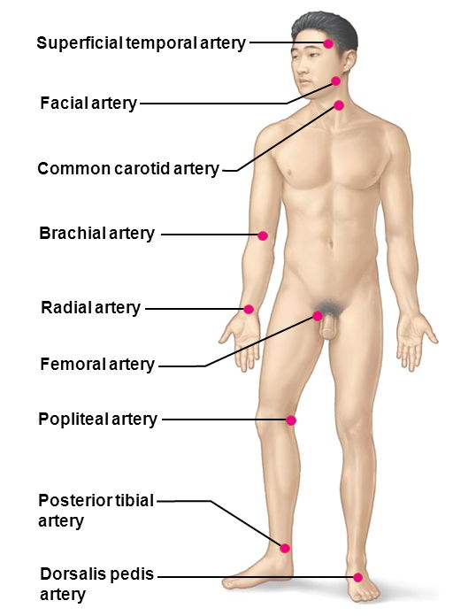
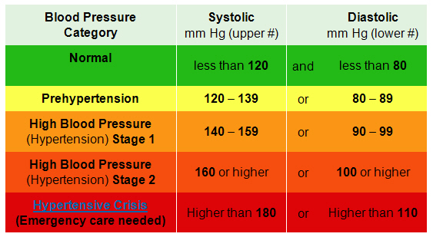
Blood Pressure
Less than 120/80 is considered “normal”
Hypotension – 90/60 or below
Systolic- maximal pressure
Diastolic- minimal pressure

Slide 54
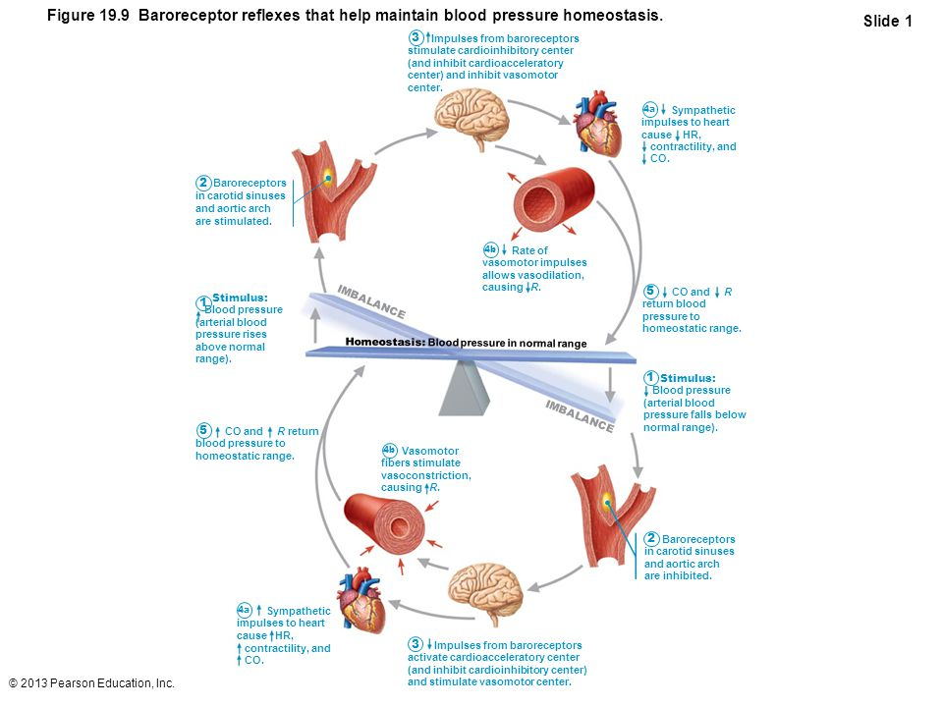

Slide 55
Primary Hypertension
Hereditary- 2x more likely
Diet- high salt and cholesterol
Obesity
Age – older than 40
Type 2 diabetes
Stress- increased sympathetic
Smoking- nicotine is a strong vasoconstrictor
Even with these- 90% are considered idiopathetic

