Slide 1
The Muscular System

Slide 2
Function of Muscles
Produce movement
Maintain posture
Stabilize joints
Generate heat
Dilate and constrict eyes/passages

Slide 3
5 Properties of muscle tissue
1.Excitable –capable of responding to nerve stimulation
2. Elasticity- Can return to original length
3.Contractable - shorten
4. Adaptable- hypertrophy / atrophy

Slide 4
Muscle Rules
Always cross joint
Can only contract to get shorter
Antagonistic muscle sets
Origin and insertion (picture)

Slide 5
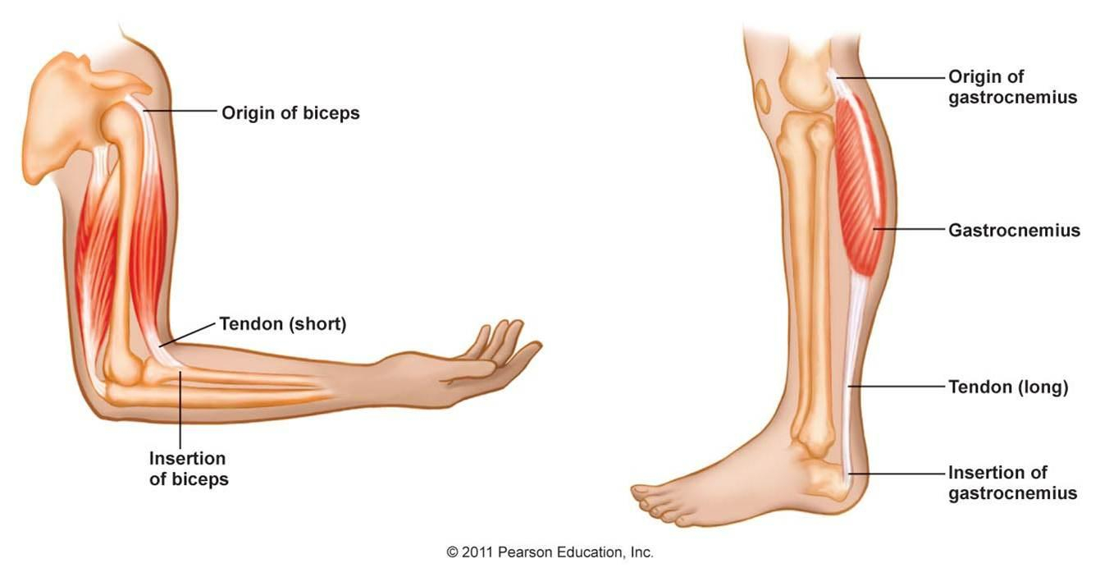

Slide 6
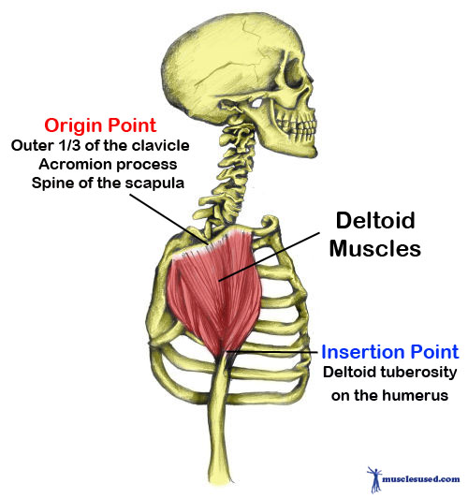
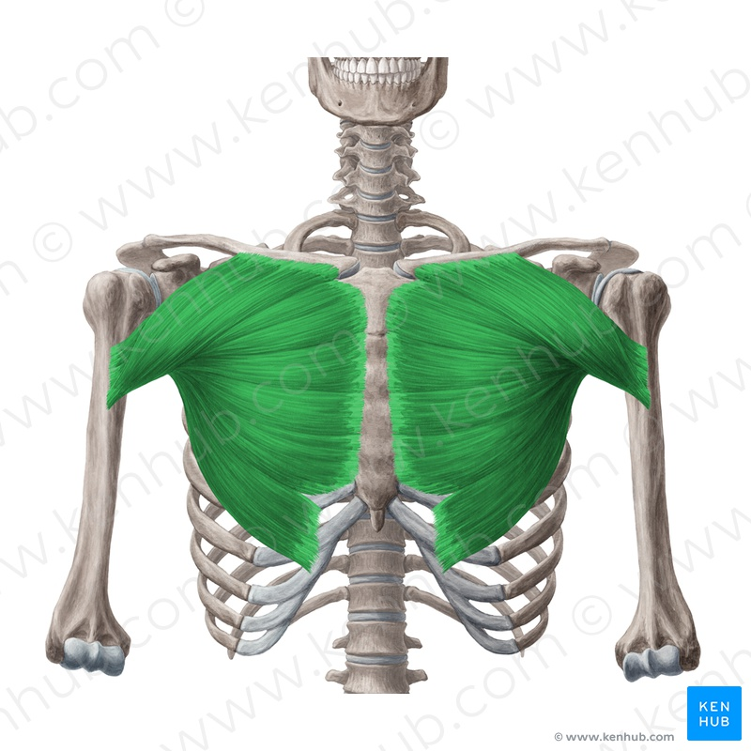

Slide 7
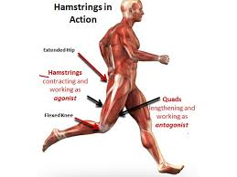

Slide 8
Blood and Nerve supply
One major nerve and artery goes into belly of muscle

Slide 9
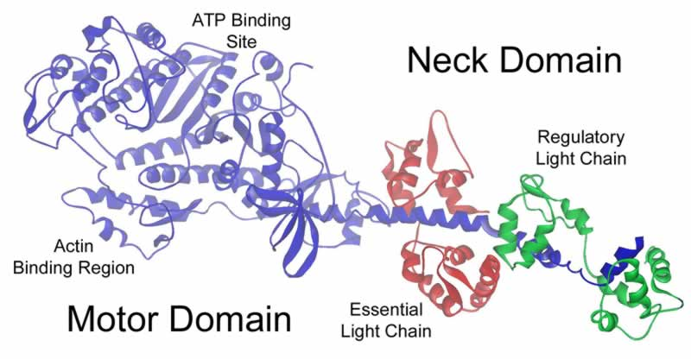
Myosin

Slide 10
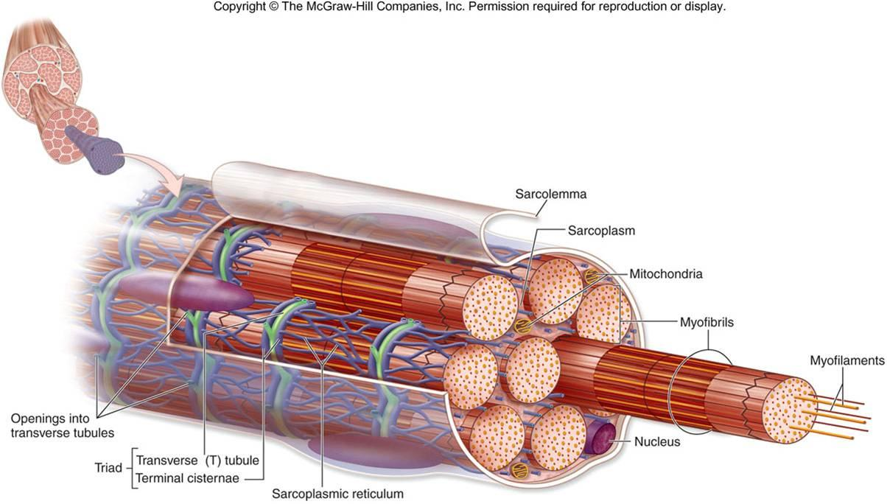

Slide 11
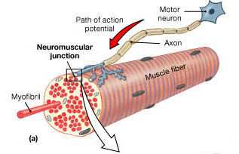

Slide 12
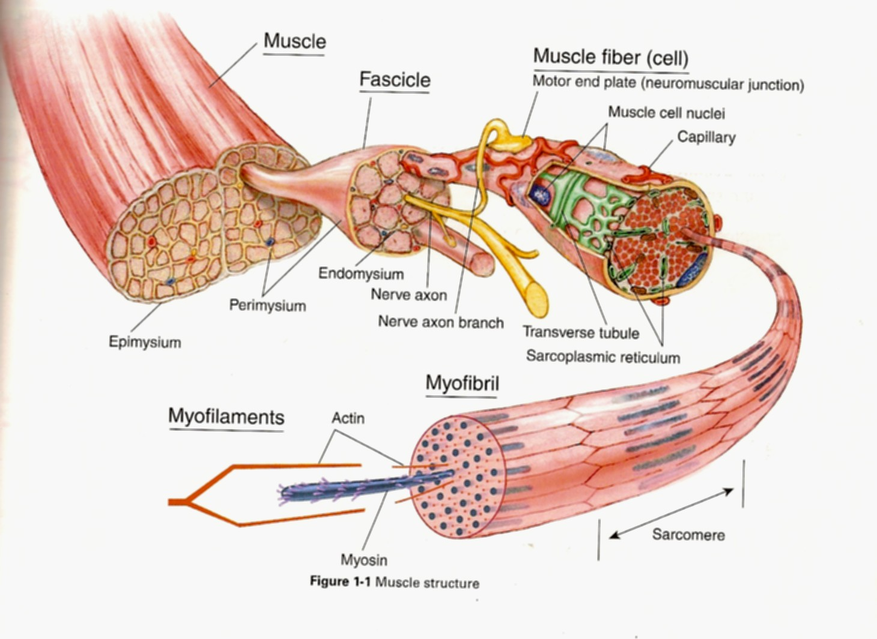

Slide 13
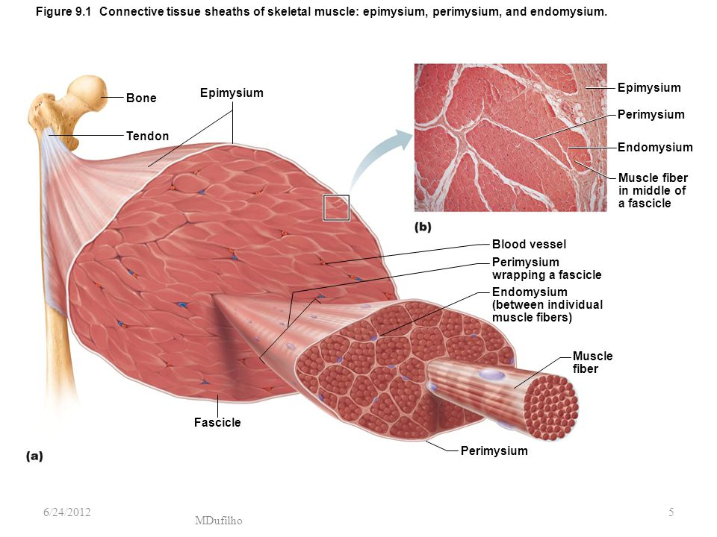

Slide 14
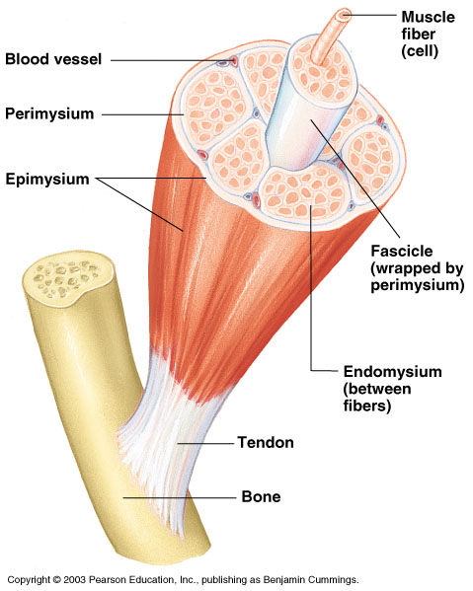
Connective Tissue Wrappings of Skeletal Muscle
Endomysium – around single muscle fiber
Perimysium – around a fascicle (bundle) of fibers
Figure 6.1

Slide 15
Connective Tissue Wrappings of Skeletal Muscle
Epimysium – covers the entire skeletal muscle
Figure 6.1

Slide 16
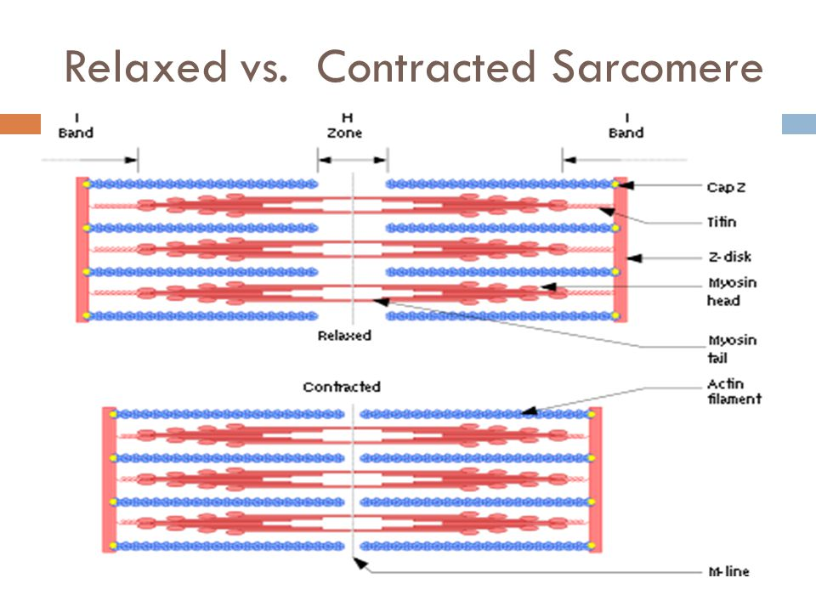

Slide 17
Unique features of skeletal muscle
Multiple nuclei- fused cells during development
High numbers of mitochondria- ATP for muscle contraction
Sarcoplasm- the cytoplasm (lots of glycogen and myoglobin)

Slide 18
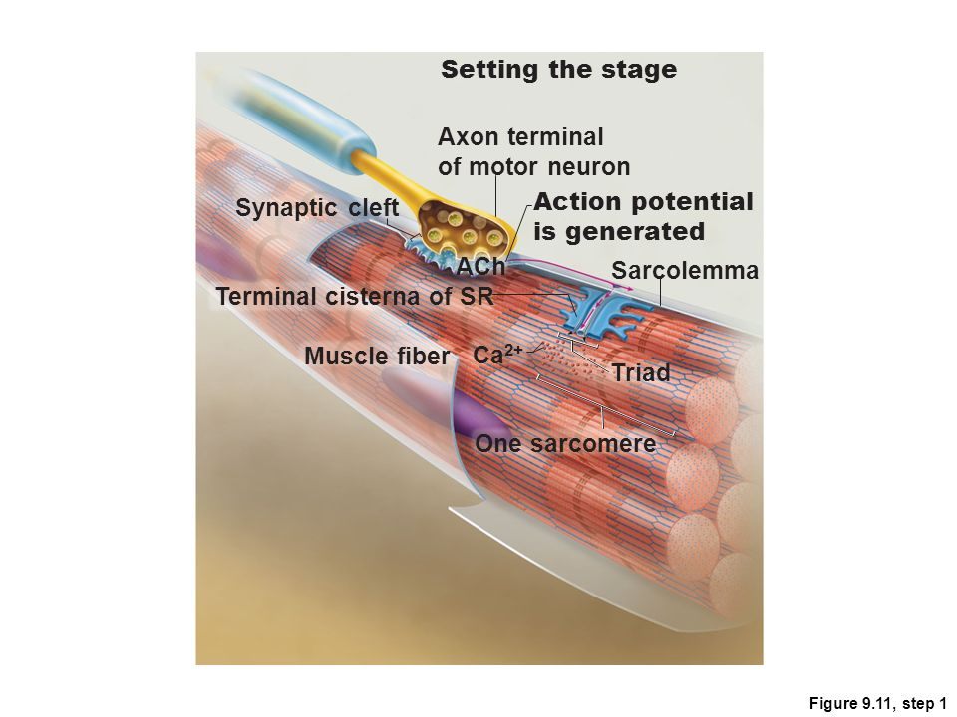
Unique Properties of muscle cells
Sarcolemma- Plasma Membrane
Unique because it can transfer electrical charge (action potential) from neurons

Slide 19
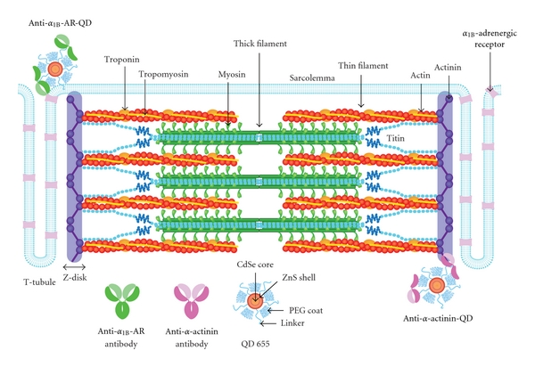
Unique Properties of muscle cells
Transverse (T) tubules- The sarcolemma folds deep into the muscle cell.
Important because they allow the
nerve signal to reach all of the
sarcomeres.

Slide 20
Unique properties of muscle cells
Sarcoplasmic reticulum
Stores calcium in the muscle cell
Modified Smooth ER
“Sweater” around the myofibrils

Slide 21
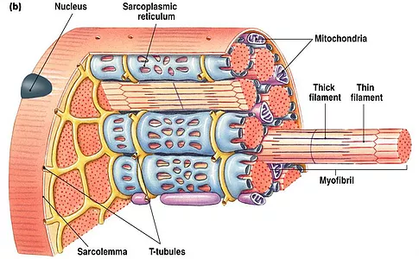

Slide 22
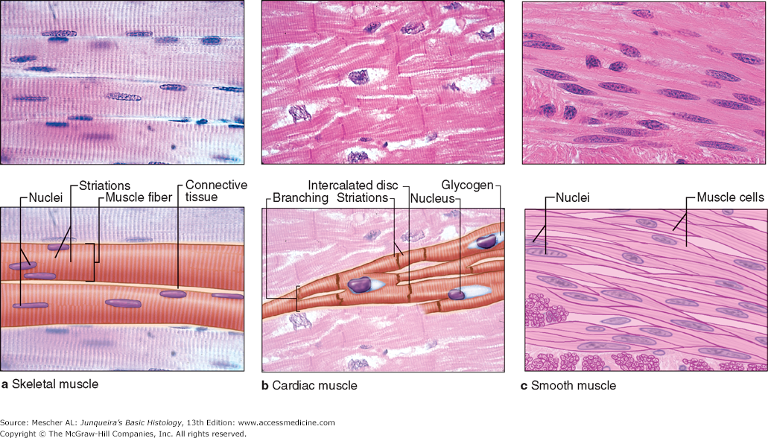
3 types of muscle

Slide 23
The Muscular System
Muscles are responsible for all types of body movement – they contract or shorten and are the machine of the body
Three basic muscle types are found in the body
Skeletal muscle
Cardiac muscle
Smooth muscle

Slide 24
Smooth Muscle Characteristics
Has no striations
Spindle-shaped cells
Single nucleus
Involuntary – no conscious control
Found mainly in the walls of hollow organs
Slow, sustained and tireless
Figure 6.2a

Slide 25
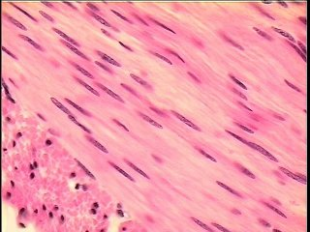

Slide 26
Cardiac Muscle Characteristics
Has striations
Usually has a single nucleus
Joined to another muscle cell at an intercalated disc
Involuntary
Found only in the heart
Steady pace!
Figure 6.2b

Slide 27
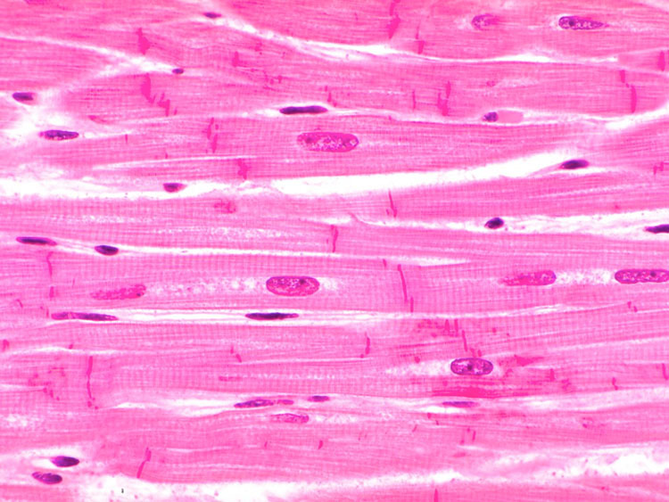

Slide 28
Skeletal Muscle Characteristics
Most are attached by tendons to bones
Cells are multinucleated
Striated – have visible banding
Voluntary – subject to conscious control
Cells are surrounded and bundled by connective tissue = great force, but tires easily

Slide 29
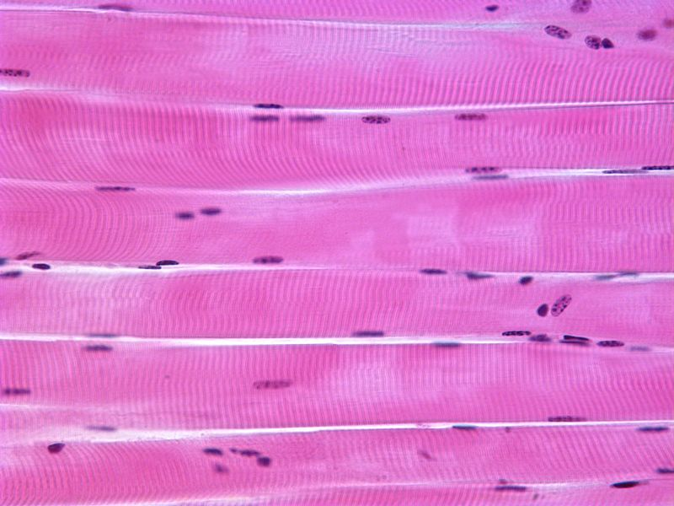

Slide 30
Turn to your neighbor and describe the levels of organization of a skeletal muscle fiber
Objective: Analyze and interpret the events of the sliding filament theory of muscle contraction

Slide 31
The Sarcomere “myofilaments”
Actin- “thin filament”
Has binding sites for myosin heads
These sites are blocked by tropomysosin
Calcium binding to Troponin unblocks the binding sites and allows the myosin heads to bind.
Myosin – “Thick filament”
Has two round “heads”
ATPase on the heads to break down ATP for energy

Slide 32
Sliding Filament Theory
Phase 1: Neuron stimulates muscle fiber
Occurs at the Neuromuscular junction
Nerves are called motor (somatic) neurons
Enter in the belly of muscle and branch out
Each muscle cell has one NMJ
Space (50nm) between the nerve fiber and muscle cell
Synaptic Cleft
ACh – Acetylcholine – a neurotransmitter located at the ends of the motor neurons.
Stored in synaptic vesicles

Slide 34
Events leading to an Action Potential
1. Action potential sent from brain to muscle cell.
2. Voltage gated Ca++ channels open in nerve at the NMJ- Calcium flows in
3. Ca+ influx causes Ach to be resynaptic cleft and binds to sarcolemma receptors.
5. Binding opens Na+ and K+ channels, more Na+ flows in than K+ out = depolarization
leased by exocytosis
4.Ach moves across 6. AP travels down T tubules to SR which triggers release of Calcium

Slide 35
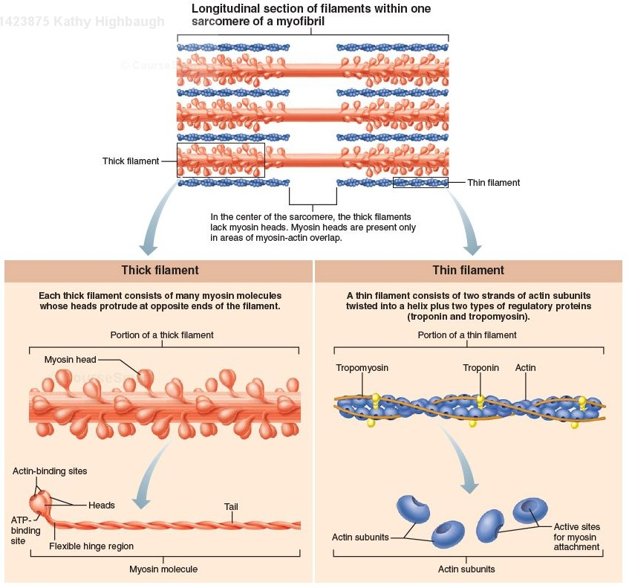

Slide 36
Sliding Filament
https://www.youtube.com/watch?v=Ktv-CaOt6UQ

Slide 37
Myasthenia gravis
Not enough Ach receptors, probably autoimmune disease.

