Slide 1
The Sliding Filament Theory
Objective: Students will be able to analyze and describe the major events that occur during skeletal muscle contraction (sliding filament theory)
Turn to your partner and discuss the relationship between these words:
CALCIUM / TROPOMYOSIN / TROPONIN / CROSSBRIDGE/ POWERSTROKE/ ATP

Slide 2
Leading up to Muscle Contraction
1. Action potential travels along the sarcolemma and down the T-Tubules
2. AP causes Sarcoplasmic Reticulum to release Ca+- Calcium flows into cytoplasm
3. Calcium binds to troponin- causes it to change shape and moves tropomyosin
4. This exposes the binding sites on actin for myosin
4. myosin binds to actin (crossbridge)- > Begins the Sliding Filament Theory

Slide 3
The Sliding Filament Theory of Muscle Contraction
Cross bridge formation- the energized myosin heads bind the actin binding site
PowerStroke- Myosin Head pull the actin towards the middle of the sarcomere. ADP & Pi released.
Cross Bridge Detachment- ATP attaches to myosin again, the head breaks off.
Cocking of the myosin head- ATP is broken into ADP and Pi and myosin head returns to its high energy position.

Slide 4
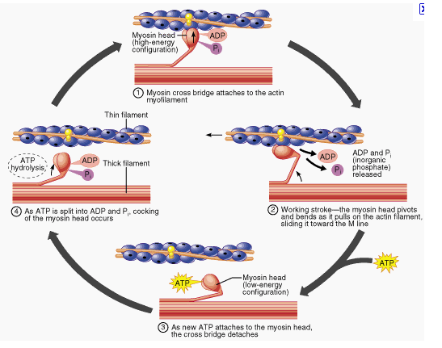

Slide 5
https://www.youtube.com/watch?v=D3JkAe838Zo

Slide 6
Rigor Mortis
Stiffening of muscles 3-4 hours after death
Peaks at 12 hrs
Ends around 2-3 days
Dying cells cannot keep Calcium out
Influx of Ca causes contraction
Crossbridges cannot be detached (run out of ATP)

Slide 7
Ending Muscle Contraction
Acetylcholine is broken down
Acetylcholinesterase
Ca+ is actively transported back into the SR
Na+/K+ pump must restore membrane potential
Why?

Slide 9
Contraction of a Skeletal Muscle
Muscle cell contraction is “all or none”
All of the myofibrils contract inside a cell or none contract
Within a skeletal muscle, not all myofibers may be stimulated at the same time
Different combinations of muscle fiber contractions may give differing responses
Copyright © 2003 Pearson Education, Inc. publishing as Benjamin Cummings

Slide 10
Muscle Tone
A small percentage of myofibers are contracted even in a relaxed muscle
Different fibers contract at different times to provide muscle tone
Involuntary control
Copyright © 2003 Pearson Education, Inc. publishing as Benjamin Cummings
Slide 6.29

Slide 11
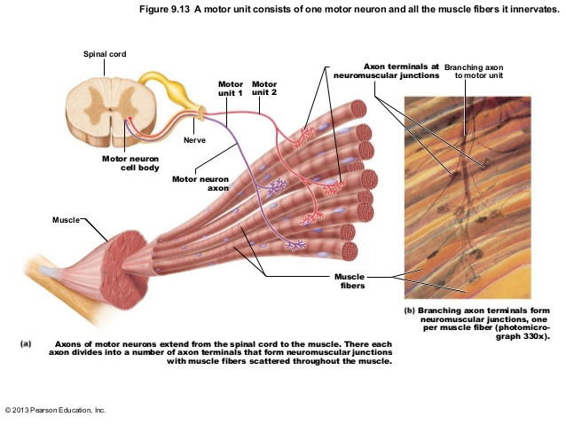
Motor Units
A motor neuron and all of the fibers it innervates (supplies)

Slide 12
Motor Units
Can be as large as several hundred fibers
Postural muscles
-Increased strength
Can be as small as 4 fibers
Eyes, fingers
-Increased precision

Slide 13
How can you increase the muscle response?
1. Increase the frequency of the stimulus
Temporal summation – each stimulus gets progressively stronger.
Even more Calcium released- stronger contraction.
Once it hits the maximal, increasing the strength will not produce any increase in strength.

Slide 14
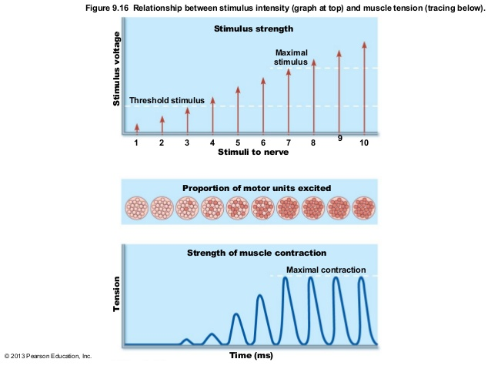

Slide 15
Energy for Muscle Contraction
Muscles can contract continuously until they run out of energy.
ATP used for:
Pumping Ca+ back into SR
Myosin detachment
ATP is the only molecule that can do this

Slide 16
Energy for Muscle Contraction
Only 4-6 seconds worth of ATP is stored by muscles
After this initial time, other pathways must be utilized to produce ATP

Slide 17
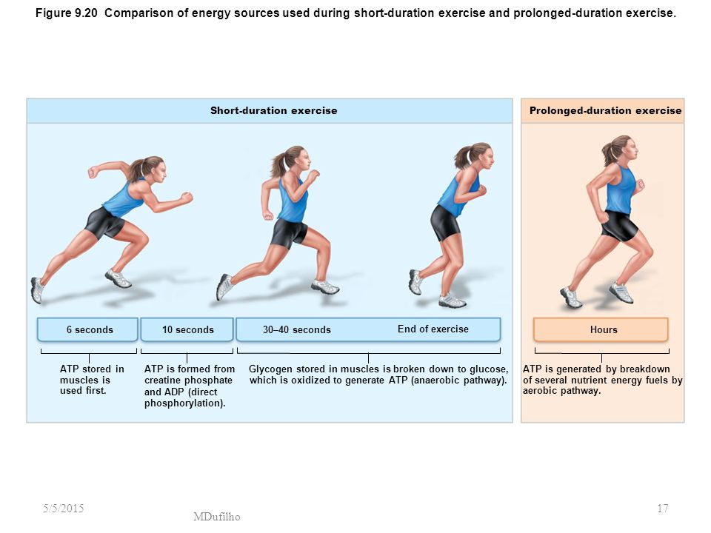

Slide 18
Types of Muscle Contractions
Isotonic contractions
Myofilaments are able to slide past each other during contractions
The muscle shortens
Isometric contractions
Tension in the muscles increases
The muscle is unable to shorten
Copyright © 2003 Pearson Education, Inc. publishing as Benjamin Cummings
Slide 6.28

Slide 19
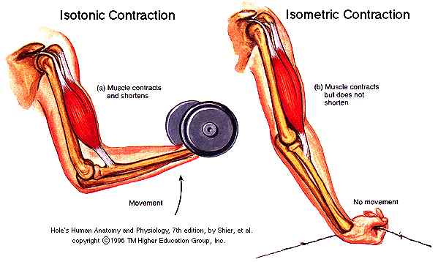

Slide 20
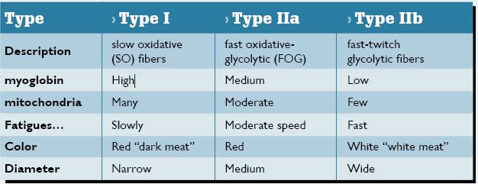

Slide 21
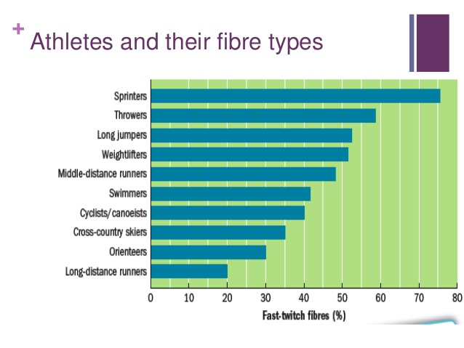

Slide 22
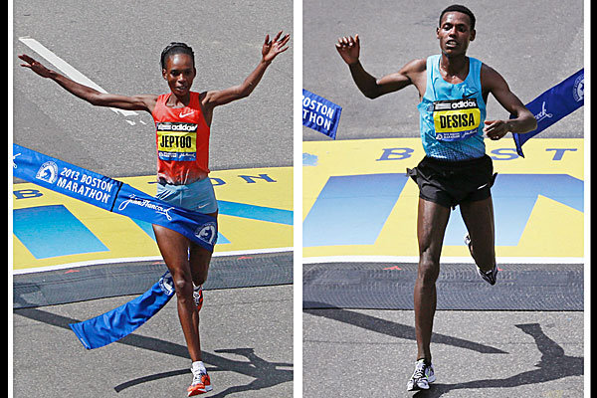
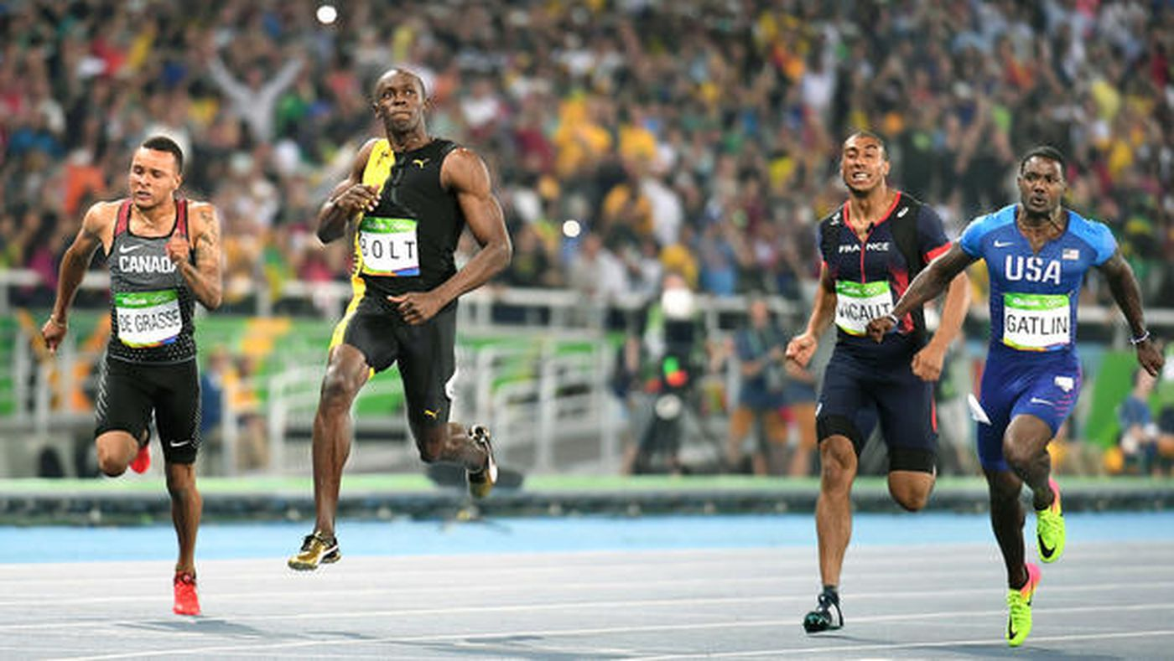

Slide 23
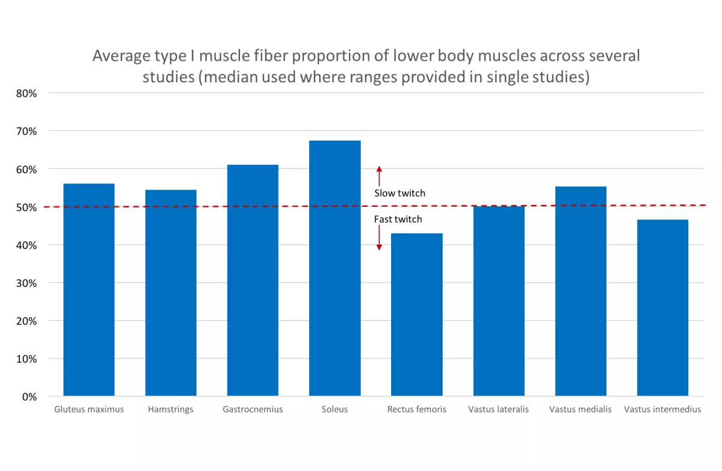
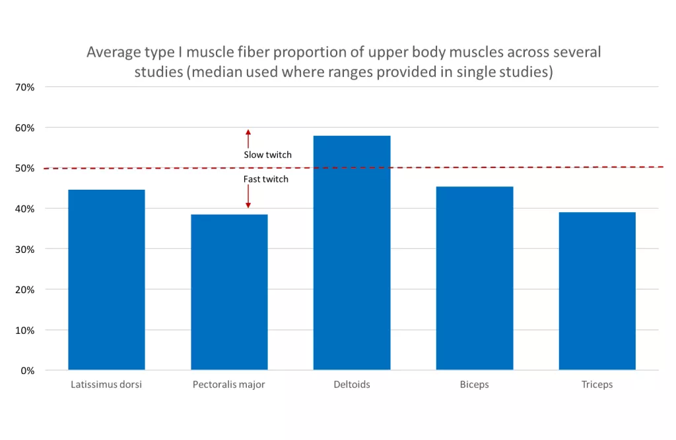

Slide 24
Muscle Fiber Type
Depends on speed of contraction and how long they take to fatigue.
Slow or Fast
Oxidative (rely on aerobic)
Glycolytic (rely on anaerobic)
Everyone has a mixture of all 3, but some genetically have more of one than another. Ex. Marathon runners have mostly slow oxidative
You cannot convert type 1 to 2, but can convert 2A to 2B

Slide 25
Myasthenia gravis
Not enough Ach receptors, probably autoimmune disease.

Slide 26
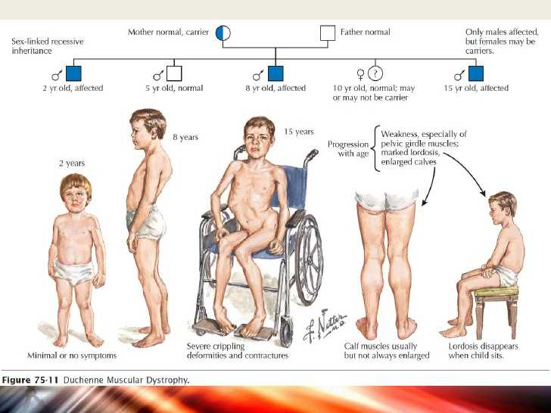
Muscular Dystrophy
Fragile Sarcolemma
Calcium flows into the cell and damaged sarcomere
Inflammation
Apoptosis
Muscle Atrophy

