Slide 2
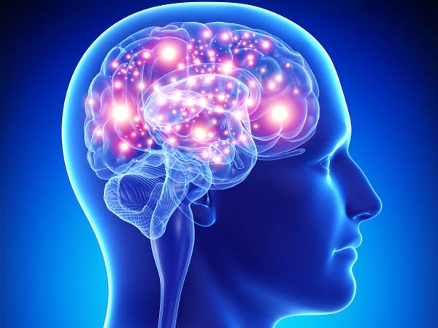
The Central Nervous System

Slide 3
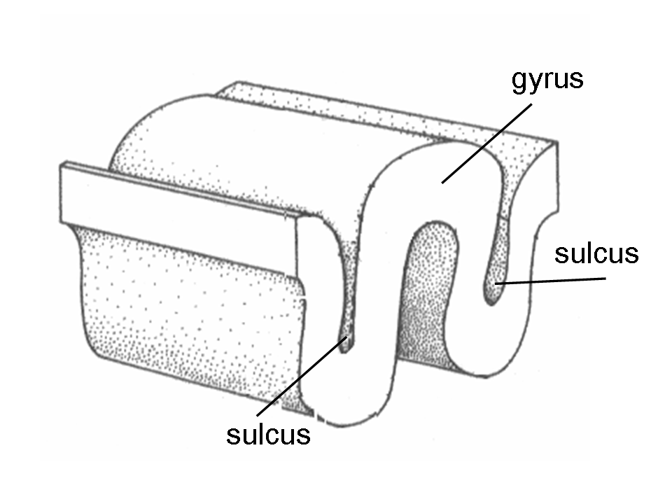
The Cerebrum
Gyri- elevations Sulci – folds
Longitudinal Fissure- separates the left and right hemisphere
Transverse cerebral fissure- separates cerebellum from hemispheres
4 Lobes- Frontal/ Parietal/ Temporal/ Occipital
Central Sulcus- separates frontal and parietal lobe
- Precentral anterior and postcentral gyrus behind
Lateral Sulcus- separates temporal from frontal and parietal

Slide 4
White and Gray matter
White matter is inside the brain and gray matter is outside
White= communication
Myelinated nerves bundled into tracts
Gray= cell bodies/dendrites/glial cells/ blood vessels
40% of brain mass
Highly folded for surface area
All neurons are interneurons in the cortex
Hemisphere- left and right side of brain
Do sensory and motor for the contralateral side of body
Can be specialized for certain functions
Connected by corpus callosum

Slide 5
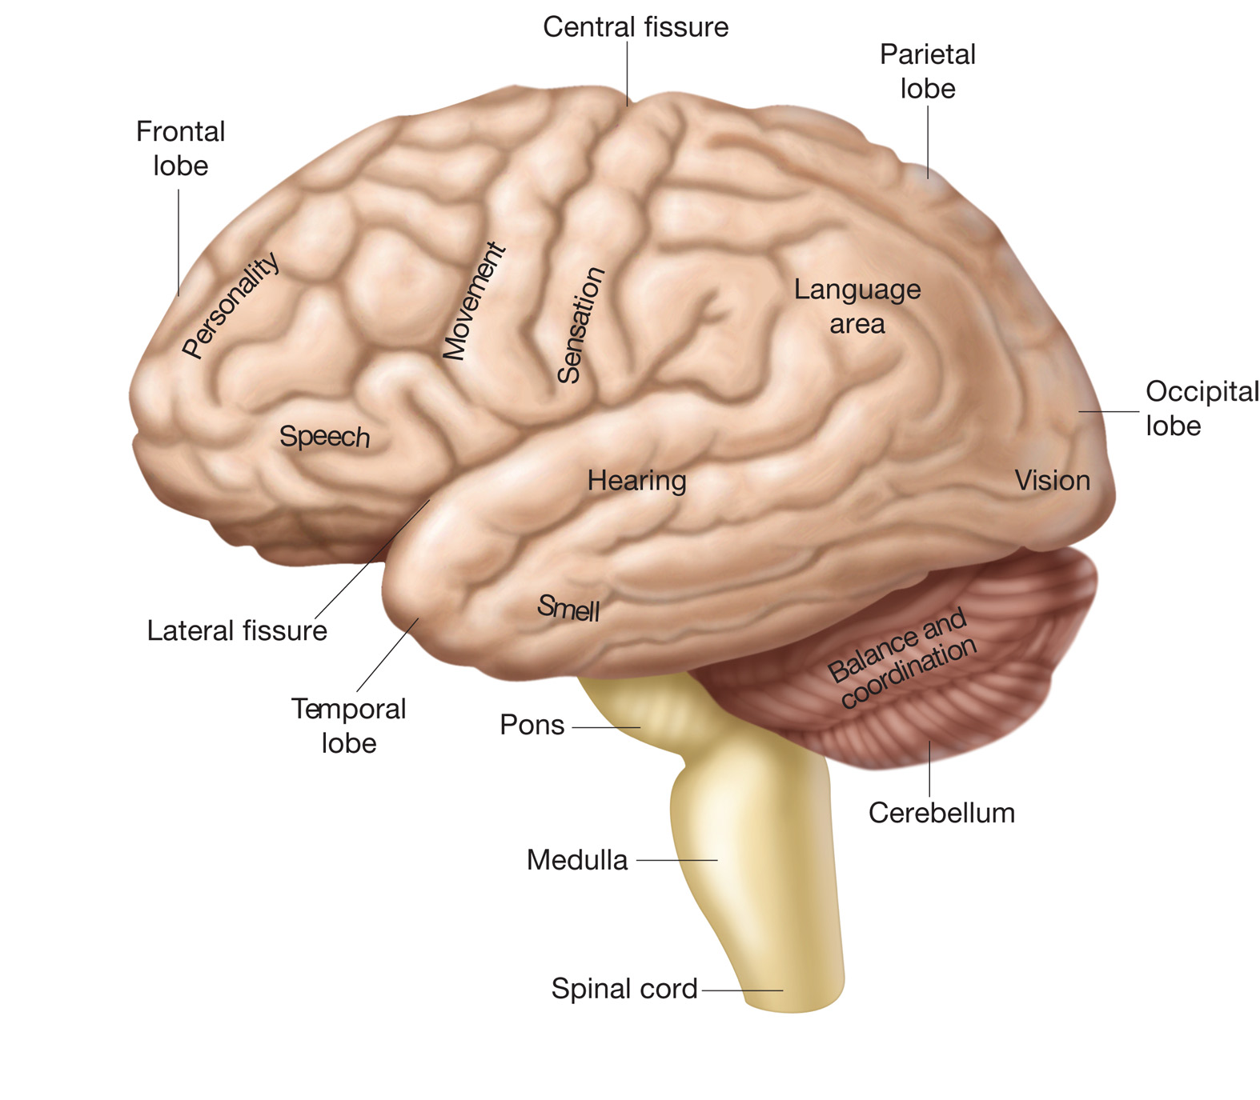

Slide 6
Frontal Lobe
Primary Motor Cortex-precentral gyrus-Conscious control of skeletal muscle voluntary movements
Premotor Cortex- Planning and selection of movements. Anterior to precentral gyrus
Speech production- Broca’s area (inferior)
Frontal Eye field- eye movements
Prefrontal cortex- complex learning abilities / personality/ judgement
“anterior association area”
Stroke to PMC= loss of voluntary movements
Stroke to Premotor= normal strength and can do movements but need retrained.
Notes:
Issues with PMC- Loss of voluntary movements only. Prefrontal- still can do movement and strength but need practice.

Slide 7
Parietal lobe: Input lobe
Primary Somatosensory cortex-postcentral gyrus
Receives info from skin and proprioceptors or muscles.
Spatial discrimination- determine where the stimulation is coming from. More neurons = more sensitive.
Somatosensory association complex- just posterior to postcentral
relay info about temperature, pressure to determine size and texture etc.
Specialized association areas
Visual /Auditory/ Olfactory/ Gustatory/ Vestibular (head in space)
Damage to association area- could reach in pockets and not recognize object like a coin.
Notes:
Damage to association area- could reach in pockets and not recognize object like a coin.

Slide 9
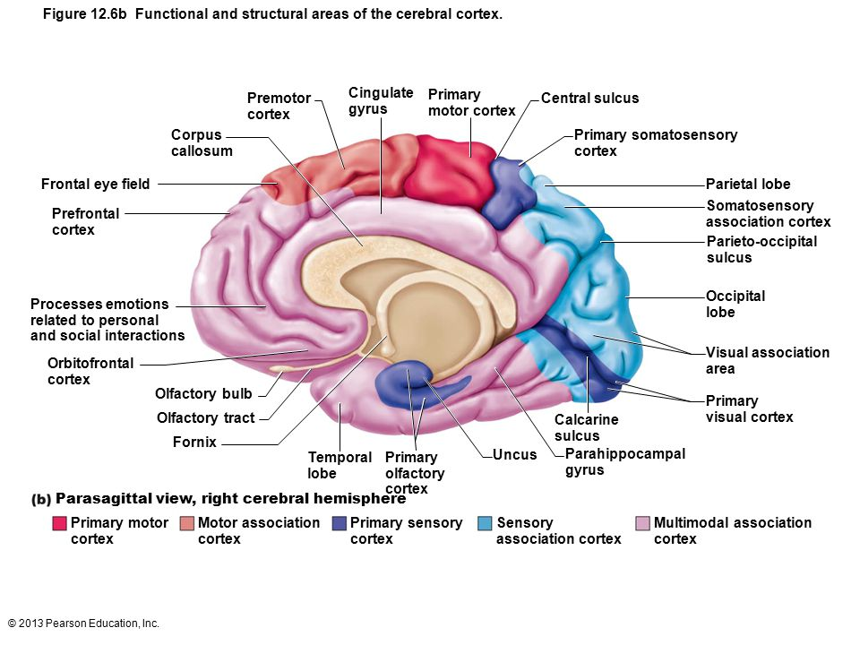
_______16) Depolarization is due to
A) potassium exiting a nerve cell
B) sodium leaving a nerve cell
C) potassium entering a nerve cell
D) sodium coming into a nerve cell

Slide 10
Cerebral dominance
Describes which hemisphere is dominant for language
90% left sided
Control math, language, logic
10% right sided
Controls intuition/ emotions/ art/ music
Tend to be left handed males

Slide 11
More lobes:
Occipital lobe:
Primary visual cortex
Visual association area-uses past visual experiences to interpret color, movement, etc.
Temporal lobe:
Primary auditory cortex- interprets pitch, loudness, location, etc.
Auditory association- memories of sound
Wernicke’s area- speech comprehension
Olfactory cortex- smell
Gustatory cortex- taste

Slide 12
Cerebral dominance
Use both cerebral hemispheres for almost everything.
Refers to which side is dominant for language.
90% left sided
Writing sentences, memorizing, etc/
10% right sided
Intuition, emotion, artistic and musical skills
Tend to be males and left handed.

Slide 13
The “Diencephalon”
Thalamus- relay station for all information coming into the cortex
-Sort out and ‘edit” info
Hypothalamus-below thalamus/ caps the brainstem
Main homeostasis control center of body
Control ANS- cardiac and smooth muscle
Limbic System- emotions
Body temperature
Food and Water intake center
Regulate sleep wake cycle
Controls Endocrine system

Slide 14
The “Diencephalon”
Pineal Gland
Releases melatonin

Slide 15
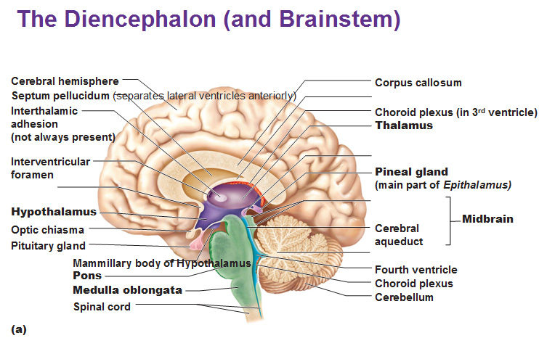

Slide 16
Brain stem
- Only 1 inch 2.5% of brain mass
1. midbrain: Most superior
auditory and visual reflexes
fluidity of movement
2. pons:
Help regulate breathing
3. medulla : Inferior
Crossover point of neurons
cardiovascular center -Blood pressure
Respiratory center
vomiting, coughing, hiccupping, sneezing, swallowing

Slide 17
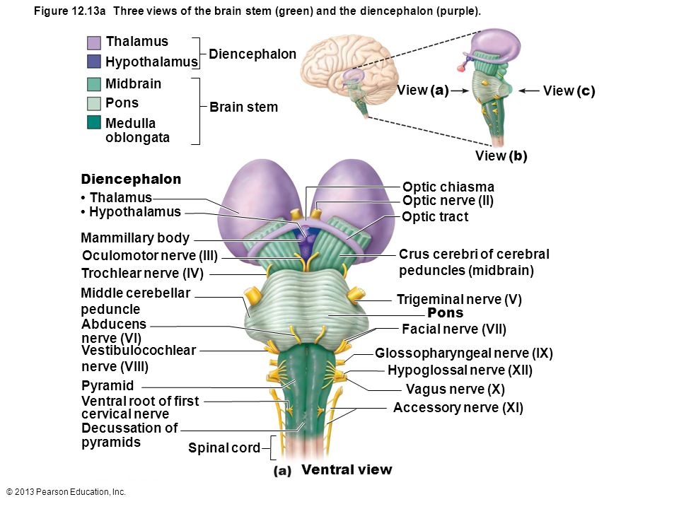

Slide 18
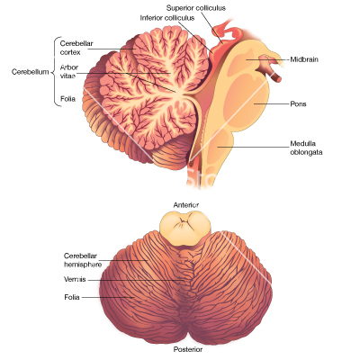
Cerebellum
11% of mass
Dorsal to the brain stem
Arbor Vitae- white matter
“tree of life”
Controls and Coordinates
Voluntary body movements
Unconscious control

Slide 19
Limbic System
A “functional” network spanning the brain
Controls emotions and feelings
Memory processing
Interacts with prefrontal lobe
Relationship between feelings and thoughts
Includes hypothalamus/ Amygdala /hippocampus

Slide 20
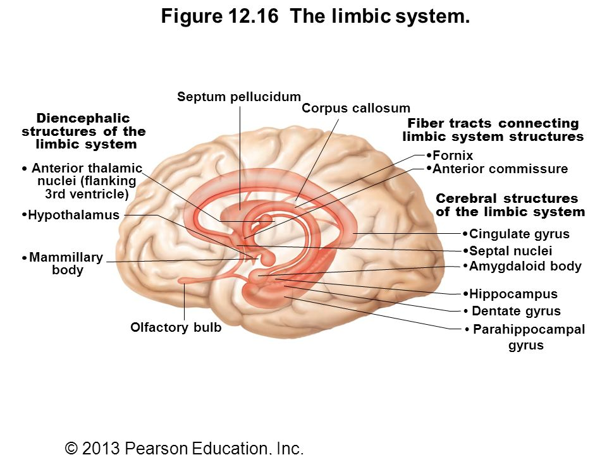

Slide 21
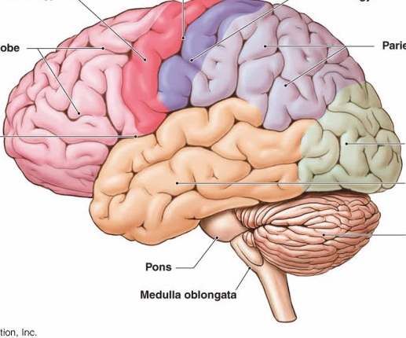

Slide 22
Meninges
Connective tissue of the CNS
Hold in CSF and blood vessels / protect
Dura Mater- tougher outer layer
Forms falx cerebri that dives into the longitudinal fissure.
Arachnoid Mater- Loose brain covering\
does not go into the sulci
Subarachnoid space- CSF
Pia mater- delicate covering that clings to brain with small arteries

Slide 23
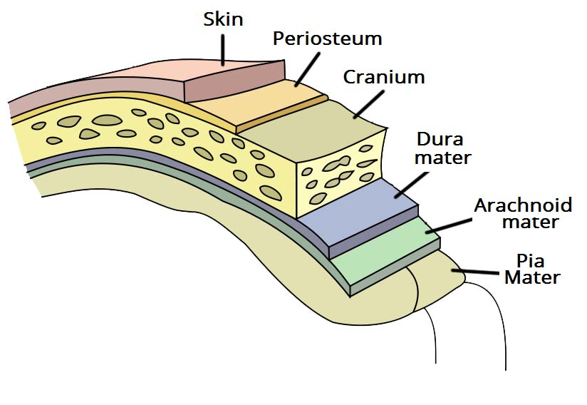

Slide 24
Head Trauma
Concussion- temporary alteration of function
Contusion- serious concussion with permanent neurological damage
Can cause coma
Subdural or subarachnoid hemorrhage- bleeding into the meninges
Initially fine then deteriorate
Forces brainstem through Foramen Magnum
Loss of control over heart rate/ respiration/ BP

Slide 25
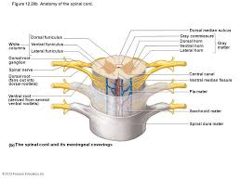
Spinal Cord Slide
Ends at L2 – Conus Medullaris
Continues as cauda equina
Ascending sensory / Descending Motor tracts
Gray matter interior (H shaped) / White matter outside
Pair of spinal nerves at each vertebrae level

Slide 26
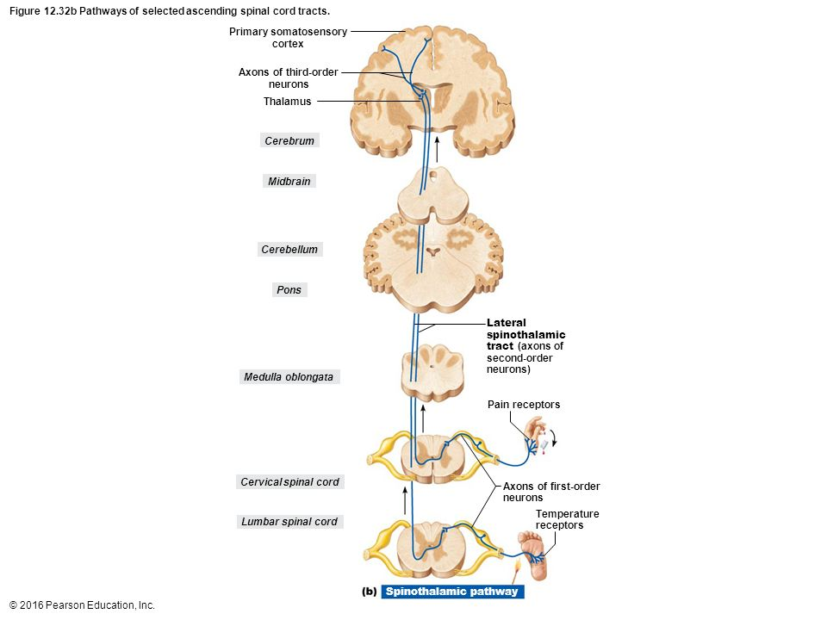

Slide 27
Spinal Cord Trauma
The spinal cord is flexible but very sensitive to pressure
Paraplegia- lower cut to the cord
Both legs paralyzed
Quadriplegia- cervical spine
All limbs paralyzed
Hemiplegia- paralysis of one side of the body
Brain issue

Slide 29
Nerve regeneration
CNS- believe most never regenerate
Astrocytes form scar tissue, oligodendrocytes inhibit growth
PNS- Can regenerate if damage is distal from cell body
Schwann cells play the key role
Form regeneration tube

Slide 30
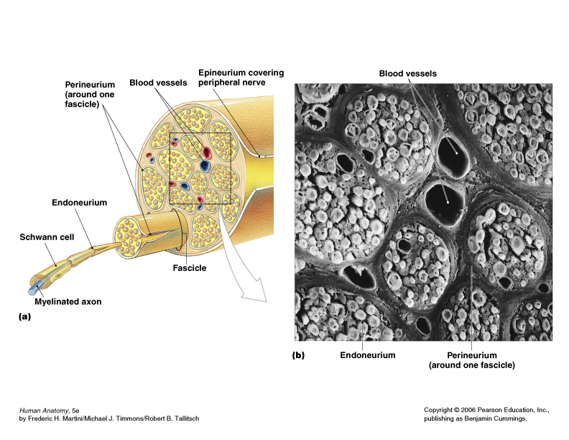
Anatomical structure of Nerves
Fig. 14.6

Slide 31
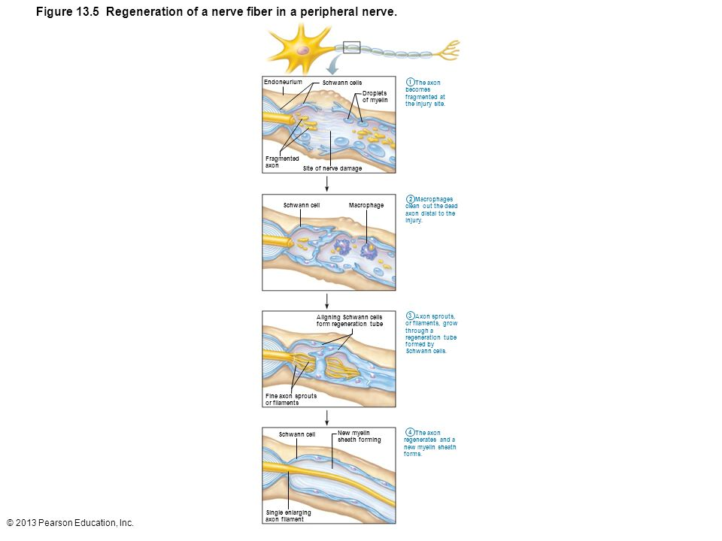

Slide 32
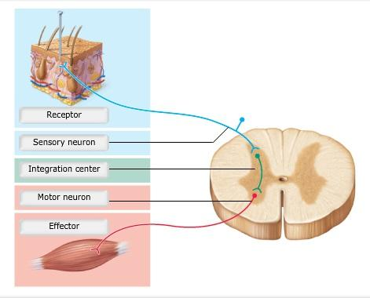
Reflexes
Can be learned or inborn
Posture control, organ control, avoiding pain
Ex. Of learned- driving a car, much becomes automatic

Slide 33
Autonomic Nervous System
All motor neurons
Effectors” Cardiac, Smooth, glands
Uses two neurons to get to effector organ- slower
Somatic nervous system- releases AcH and always excites
Autonomic- Releases NE and AcH and can excite or inhibit
2 Branches
Sympathetic- Flight or Fight
E’S “excite, emergency, embarrassed, exercise)
Decreased blood flow to organs, increased to heart and muscles
Increased respiratory rate
Increased glucose release
Parasympathetic- Rest and Digest

Slide 34
