Slide 1
Urinary System
Water control and nitrogen disposal

Slide 2
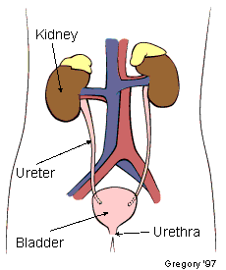
Urinary system anatomy
Kidneys
Ureters-paired tube from kidney to bladder
Bladder-temporary storage for removal
Urethra

Slide 3
Function of the kidney
Regulating total water volume
Regulating concentration of ions
Excreting wastes and toxins
Hormone production- EPO and Renin
Acid Base Balance

Slide 4
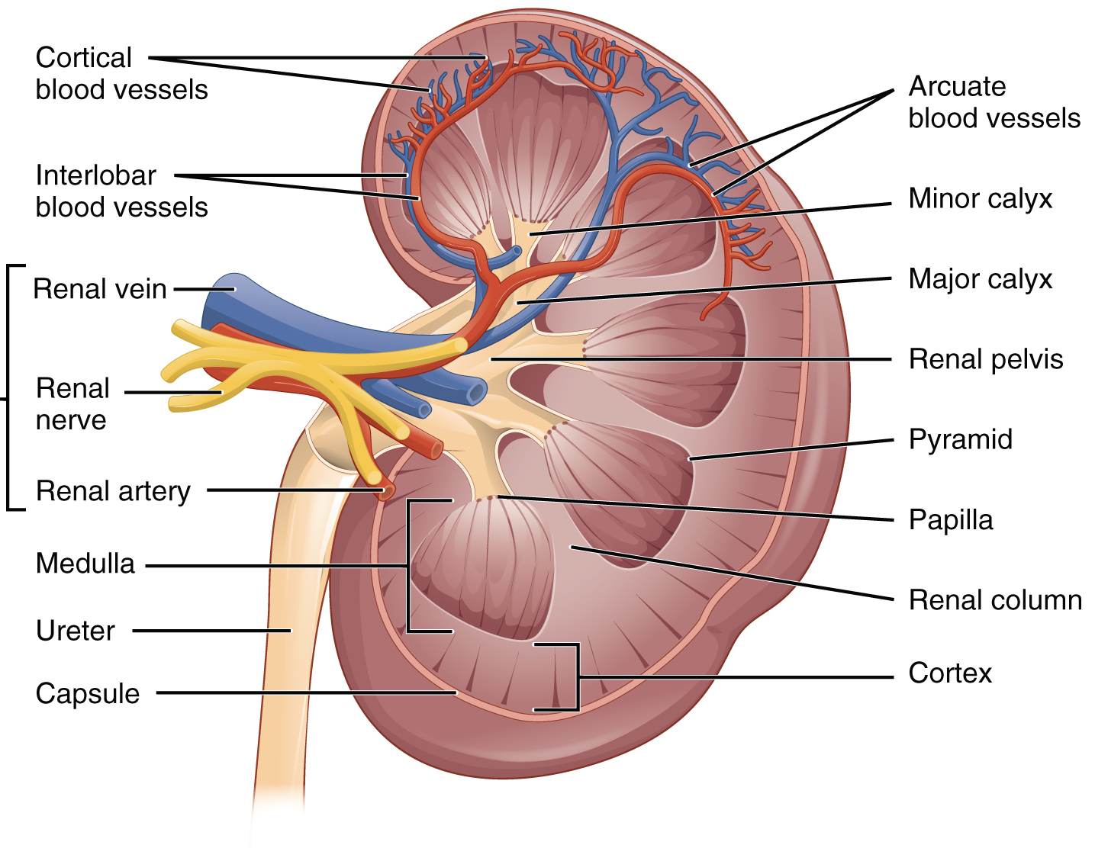
Anatomy of the Kidney
Main structures of the mammalian kidney:
renal cortex
renal medula
renal pelvis
Nephrons
Hilum

Slide 5
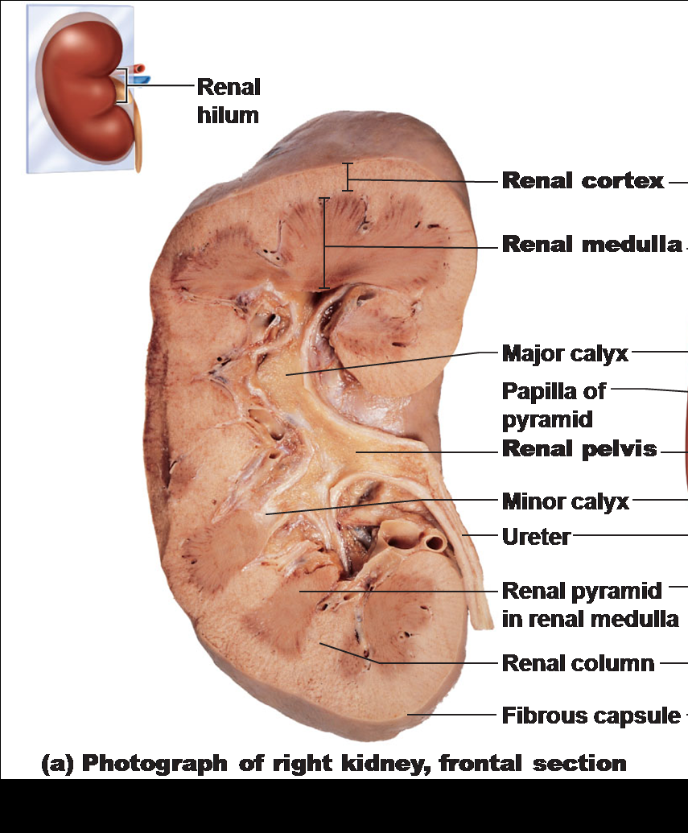

Slide 6
Anatomy of urinary system
Ureters- from each kidney into the bladder
Kidney stones- (Renal calculi)- calcium or magnesium forms sharp stones.
Can obstruct ureter
Sx: radiating flank pain
Treatment: Shock wave lithotripsy- pulverize the stone.
Urinary Bladder- Transitional Epithelium

Slide 7
Urethra
Tube from urinary bladder to outside world.
Females have shorter urethra
- Urinary Tract infections
- Fecal bacteria grow inward.
- Sx: painful urination, increased frequency and urgency, fever.
- Can turn into more severe if not treated.
- Cystitis- Bladder infection
- Pyelonephritis- Kidney infection

Slide 8
Hormones of reabsorption
1. Antidiuretic Hormone- (ADH) inhibits urine formation by decreasing pores in the membranes.
Made by pituitary
2. Aldosterone- Regulates Na+ reabsorption- released in response to low blood pressure or high K+.
Increases Na+ reabsorption which water follows.
Made by renal cortex
3. Atrial Natriuretic Peptide- (ANP) – Aldosterone's opposite
4. Parathyroid hormone- increases Ca+ reabsorption.

Slide 9
Kidney regulation of blood volume
Renin is an enzyme released when Blood Pressure drops to catalyzes the production of angiotensin, a hormone that causes arterioles to constrict, raising blood pressure.
Erythropoietin travels to the bone marrow and stimulates the production of new blood cells

Slide 10
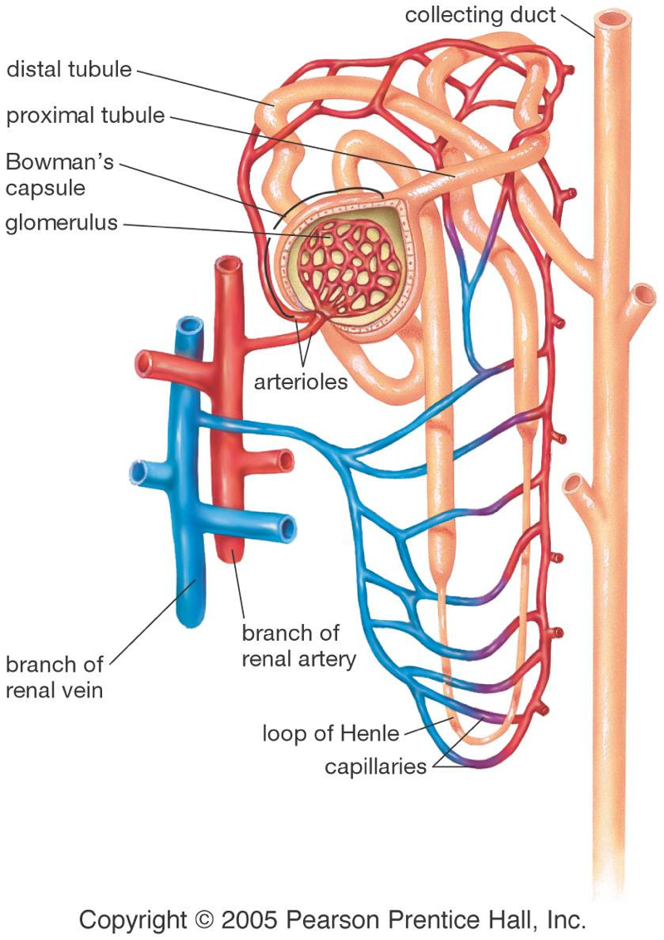
Anatomy of the Nephron
Glomerulus
Proximal tubule
Loop of Henle
Distal tubule

Slide 11
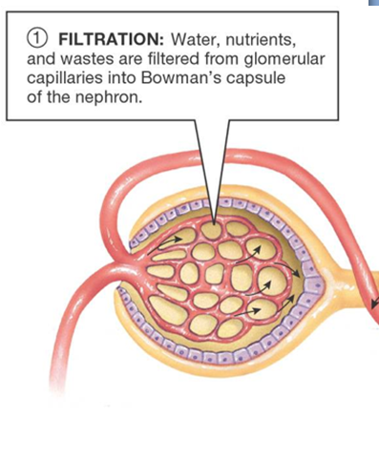
Glomerulus
This is the only place in the system where the blood is actually “filtered.”
Blood pressure is used to push plasma through capillary walls and into the Bowman’s (glomerular) capsule.

Slide 12
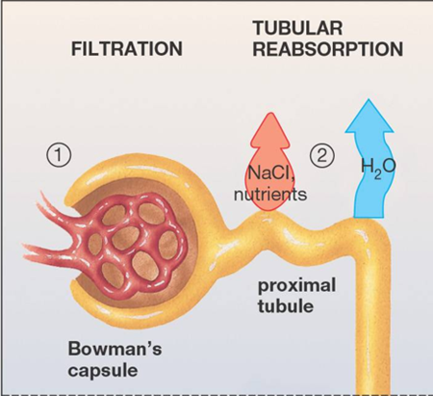
Proximal tubule
Nutrients (Na, Cl- , Mg+ , K+,. Glucose, AA’s, vitamins, water) are moved out of the tubule through active transport.
Water follows the nutrients by osmosis.

Slide 13
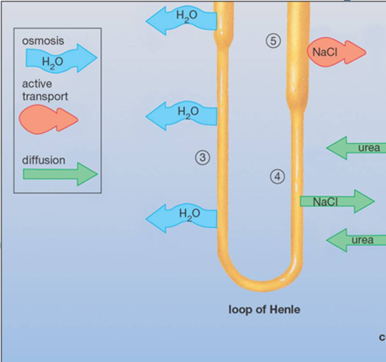
Loop of Henle
Tissue around the Loop of Henle is salty, from active transport and diffusion of sodium chloride.
The salty conditions allow water to diffuse out of the loop.

Slide 14
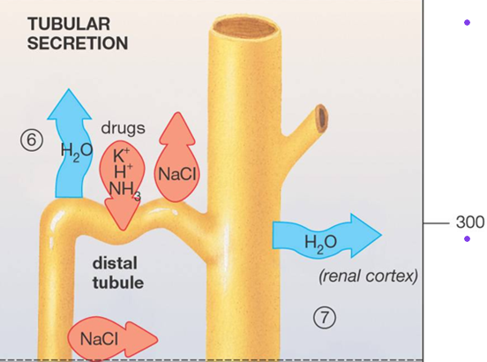
Distal tubule
Active transport is used to move more nutrients out of the concentrated urine.
Some ions, drugs, and toxins are actively pumped into the tubule.

Slide 15
Which of these happens during filtration?
Salt is actively pumped out.
Water is removed osmotically from the filtrate.
Plasma moves from capillaries into the capsule.
Toxins are actively removed from plasma.

Slide 16
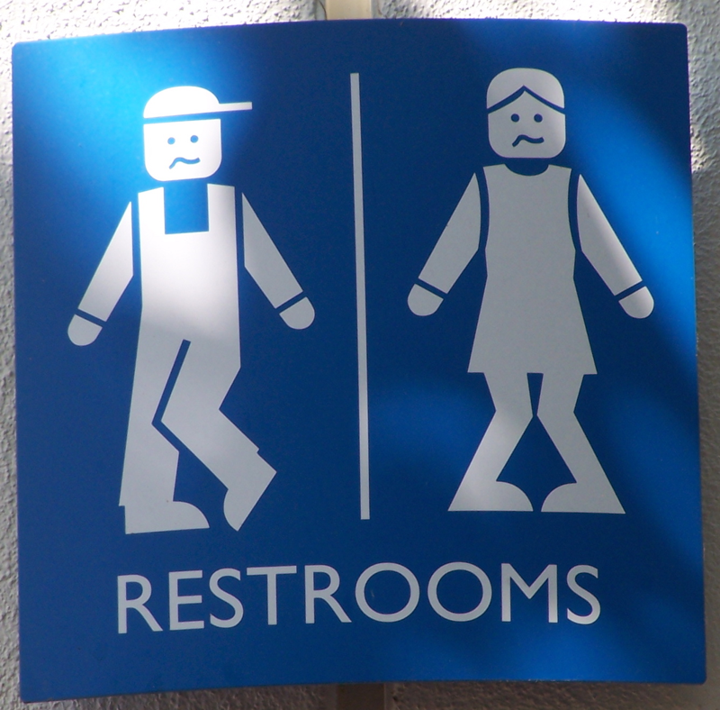
Urea removal

Slide 17
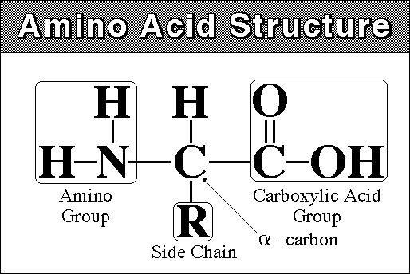
Amino acid metabolism
Amino acids are the building blocks of protein. If not needed for building protein, then can be metabolized for energy, or broken apart and the carbon chains used to make fat.
Metabolism requires removal of the amine unit (NH3).

Slide 18
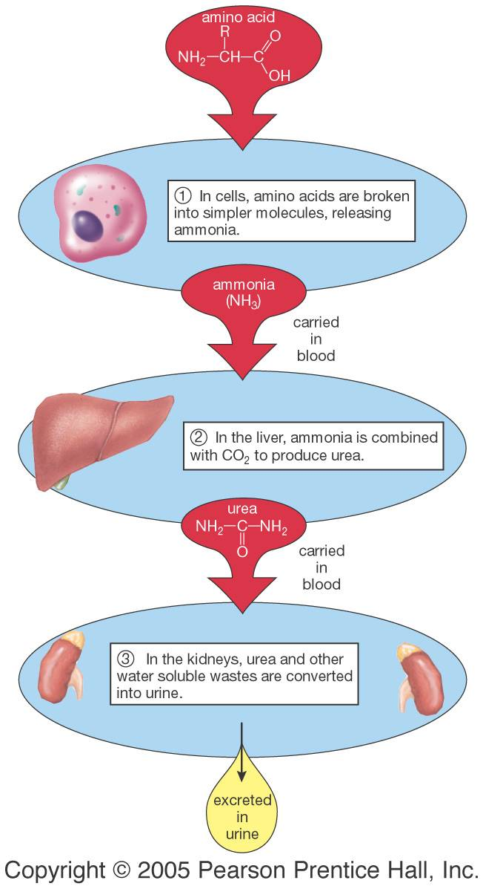
Ammonia and Urea
Ammonia is toxic and highly water soluble.
The liver turns ammonia into urea, which is less toxic and less soluble.
Notes:
What is the advantage? Would accumulate in the blood

Slide 19
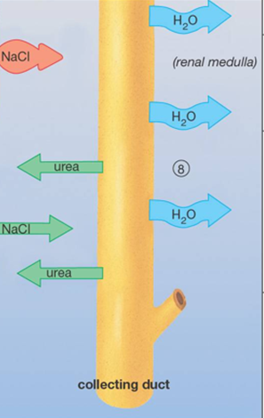
Collecting Duct
More water leaves the tube by osmosis, since the tube is surrounded by salty tissue.
Some urea leaves by diffusion, and may be cycled through the system.

Slide 20
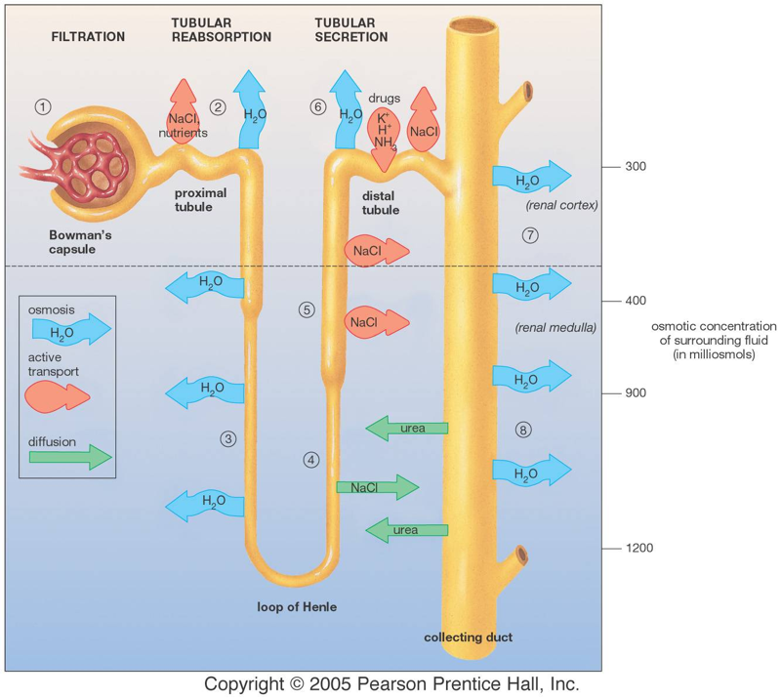

Slide 21
Which of these aids in water recovery from the filtrate?
Active transport of water out of the tubules.
Active transport of sodium out of the filtrate.
Peristalsis in the Loop of Henle.
Concentration of urea in the urine.

Slide 22
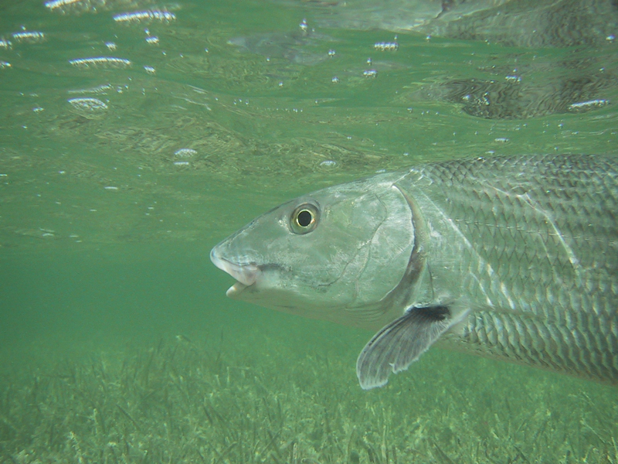
Water Regulation

Slide 23
Regulating water
Antidiuretic hormone (ADH, also called vasopressin) is part of a negative feedback system that regulates water in the mammalian body.
ADH increases the permeability of the distal tubule, allowing greater water recovery.

Slide 24
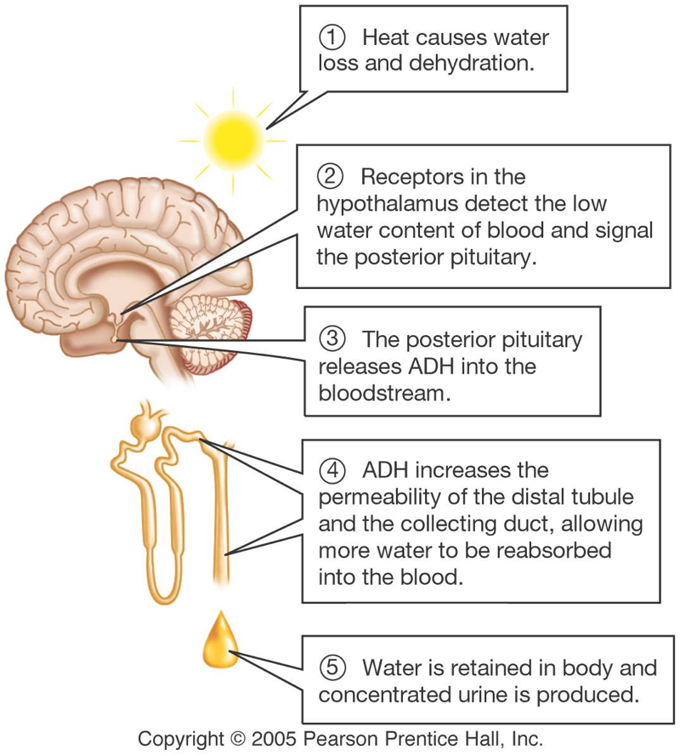

Slide 25
W
O
R
K
T
O
G
E
T
H
E
R
Caffeine and alcohol are diuretics. Alcohol inhibits ADH release, while caffeine interferes with its activity. Part of the symptoms of a hangover are due to dehydration. What causes the dehydration? And why is a cup of coffee not a good cure for a hangover?

Slide 26
If a person were given a dose of ADH, what would happen?
More water lost through kidneys.
More potassium secreted by nephron.
More water retained in the kidneys.
More sodium secreted by nephron.

Slide 27
W
O
R
K
T
O
G
E
T
H
E
R
Many over-the-counter herbal diet aids claim to “detoxify” the body or “flush fat.” Many of these contain dandelion leaves, parsley, or other herbs known to be diuretics. If a person tries these products and appears to lose pounds, what is actually lost? Could there be health problems with using these products?

Slide 28
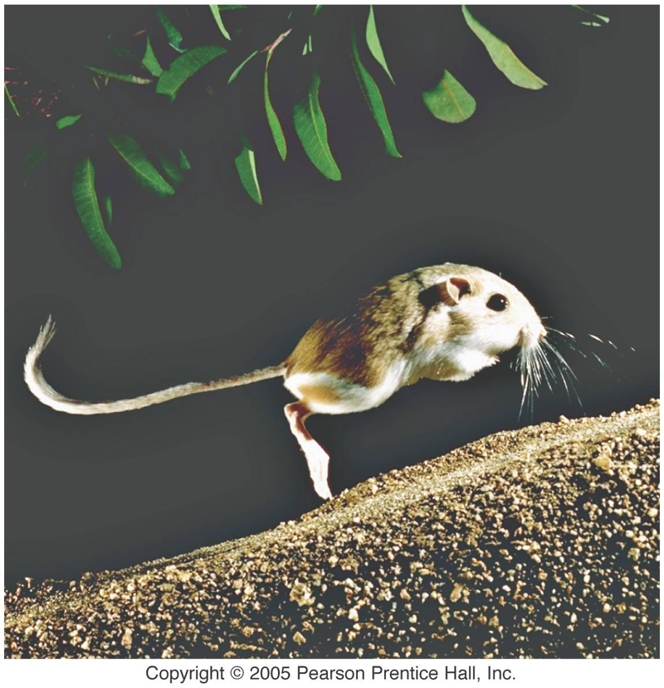
Final thinking question:
The kangaroo rat is adapted to desert life. It survives on very little water. List some ways in which its kidneys might be different from the human kidney to allow it to conserve as much water as possible.

